Slide 1
Taiwan MMN Experiment
MMN calculated with Emotional Deviant – Neutral Deviant
For a min peak between 150ms-250ms post stimulus
With average range of 25 value on each side of peak

Slide 2
Experimental Design - Blocks
Block presentation was offset according to subject (ie. sub1 started at Neutral/Angry, sub2 started at Angry/Neutral etc.)
Standard (s11, s12, s13) | Deviant (s2) | Marker *
Neutral | Angry | s27
Angry | Neutral | s28
Neutral | Sad | s29
Sad | Neutral | s30
Neutral | Fear | s31
Fear | Neutral | s32
* Block markers are present at both the beginning and end of each block

Slide 3
Experimental Design - Trials
Blocks consisted of 25 trials in which the deviant was presented twice
Event pairs were randomly distributed within a trial
Sound Stimulus | Condition | Stim Code | # in trial | # in block
Standard | First sound in standard pair | s12 | 8 | 200
 | Second sound in standard pair | s13 | 8 | 200
 | Second sound in deviant pair | s11 | 2 | 50
Deviant | First sound in deviant pair | s2 | 2 | 50
Trial example:
0.5s
0.5s
0.5s
0.5s
First Standard (s12)
Second Standard (s13)
Deviant Standard (s11)
Deviant (s2)
Note: early datasets inverted presentation of Deviant and Deviant Standard
0.6s
0.6s
0.6s

Slide 4
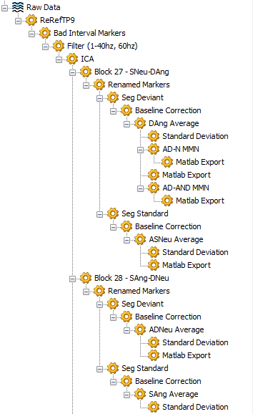
Analysis Pipeline - BrainProducts
Block Boolean:
FIRST (Stimulus, S 11, *, *) OR FIRST (Stimulus, S 2, *, *) OR FIRST (Stimulus, S 12, *, *) OR FIRST (Stimulus, S 13, *, *)
Standard (s11, s12, s13) | Deviant (s2) | Marker
Neutral | Angry | s27
Angry | Neutral | s28
Neutral | Sad | s29
Sad | Neutral | s30
Neutral | Fear | s31
Fear | Neutral | s32
Deviant Boolean:
LAST (Stimulus, Standard, -2000, 0)
Standard Boolean:
FIRST (Stimulus, Deviant, 0, 2000)
Notes:
Note: I applied a Fourier transform to the data after Fa-Hsuan’s suggestion and found a large number of the data sets did have frequency peaks at 60hz, therefore I kept the notch filter as part of the pipeline

Slide 5
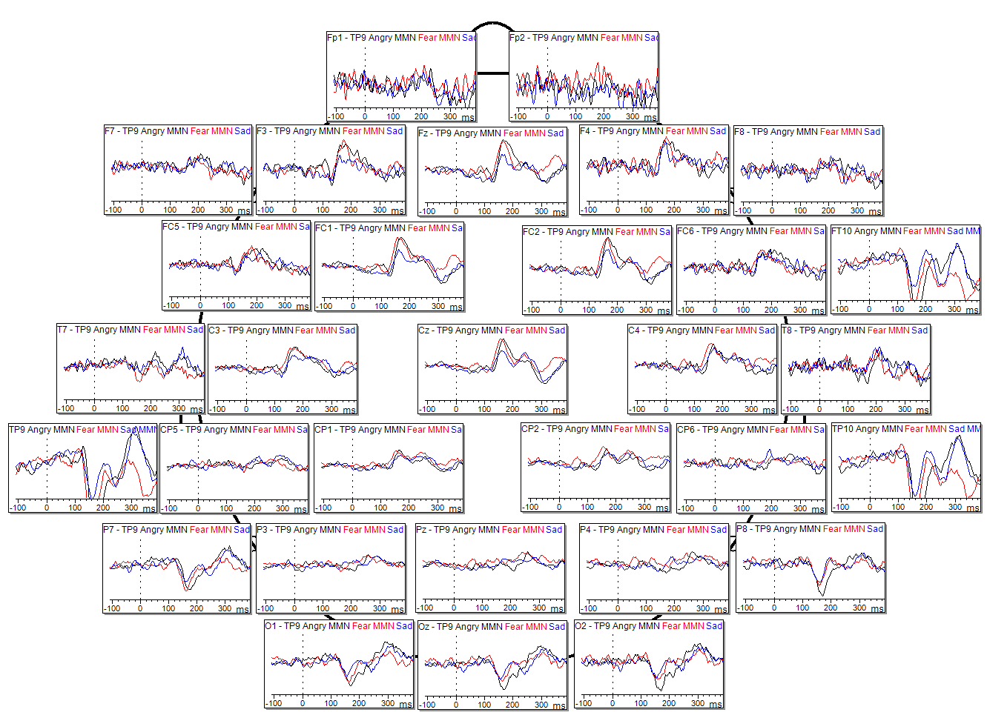
Group Results – Angry vs Sad vs Fear
Scale: 5µV

Slide 6
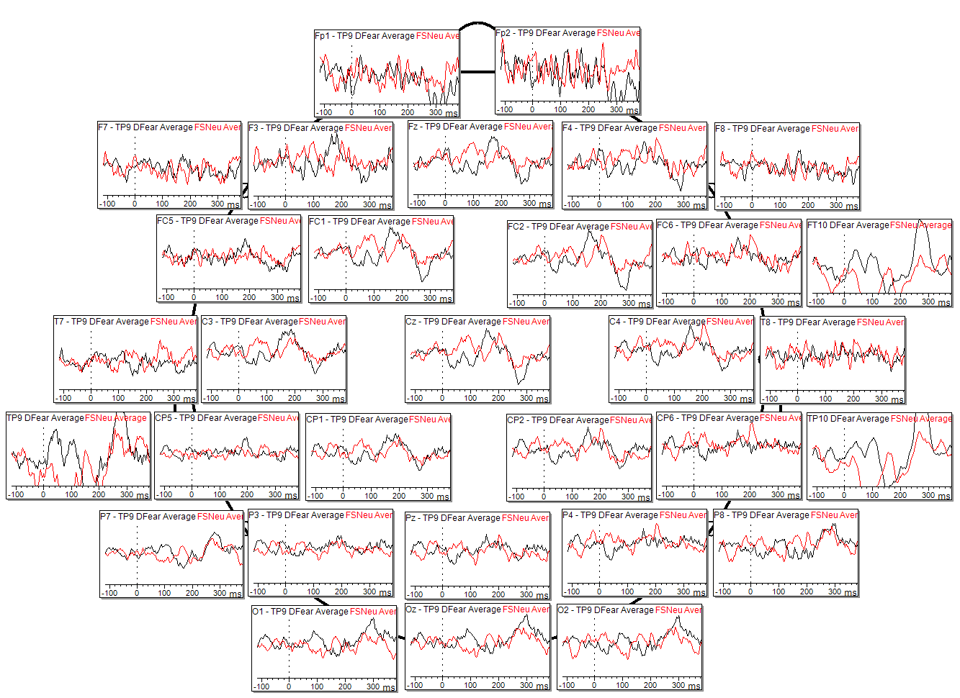
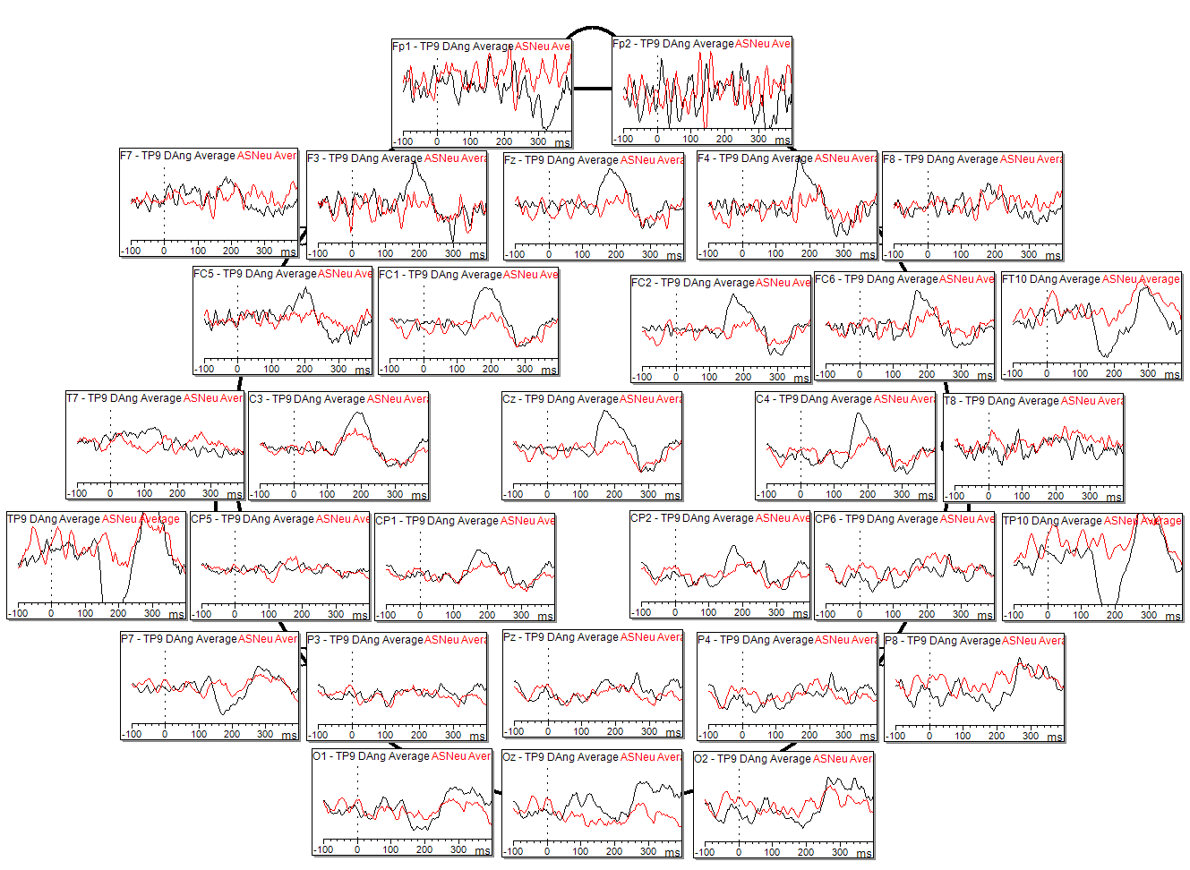
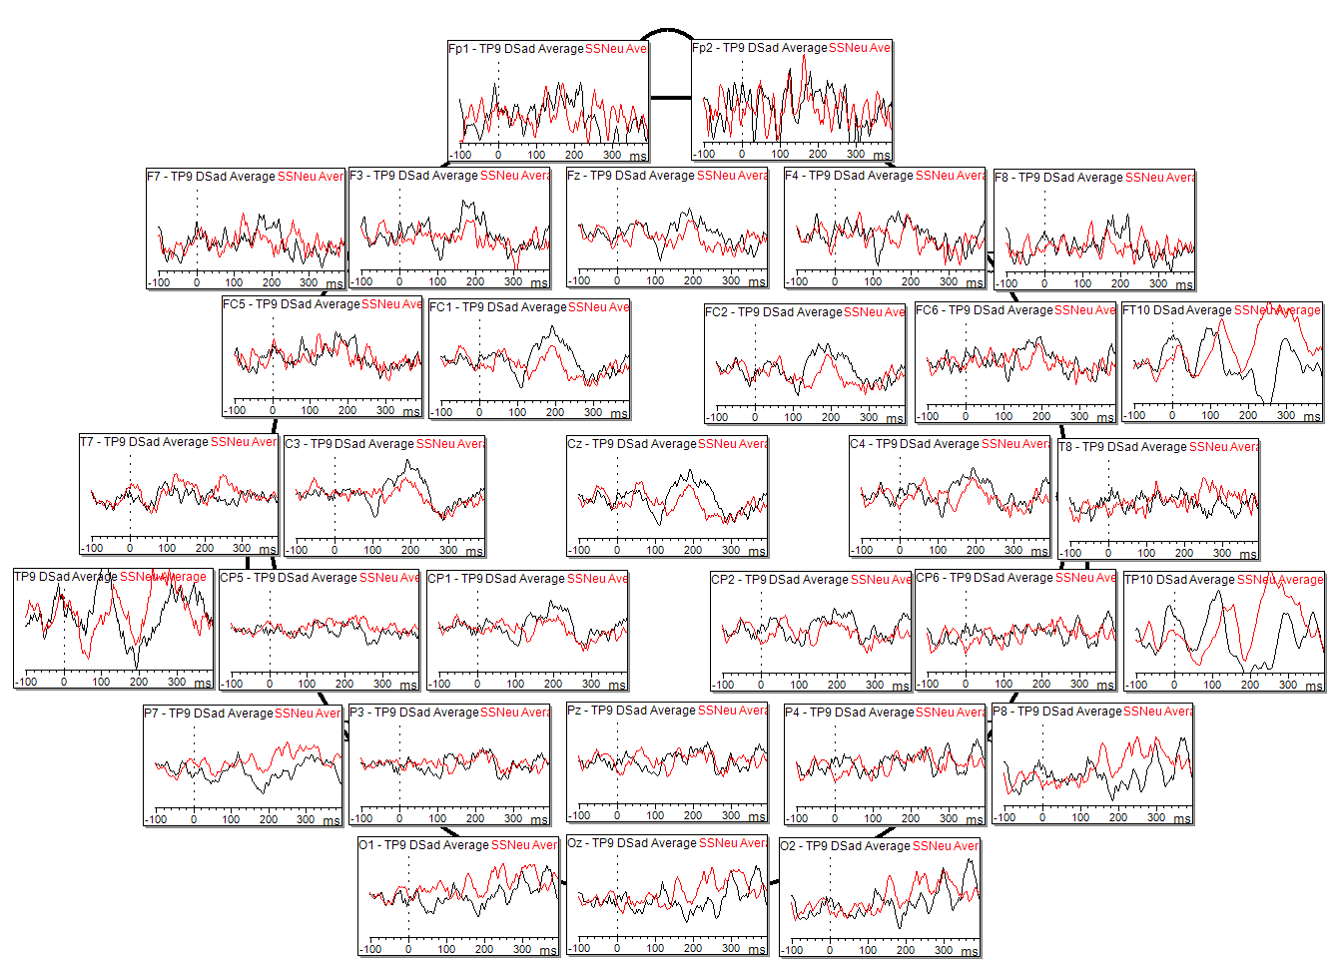
Individual Results – Sub001
Fear Deviant vs Neutral Standard
Angry Deviant vs Neutral Standard
Sad Deviant vs Neutral Standard
Scale: 10µV

Slide 7
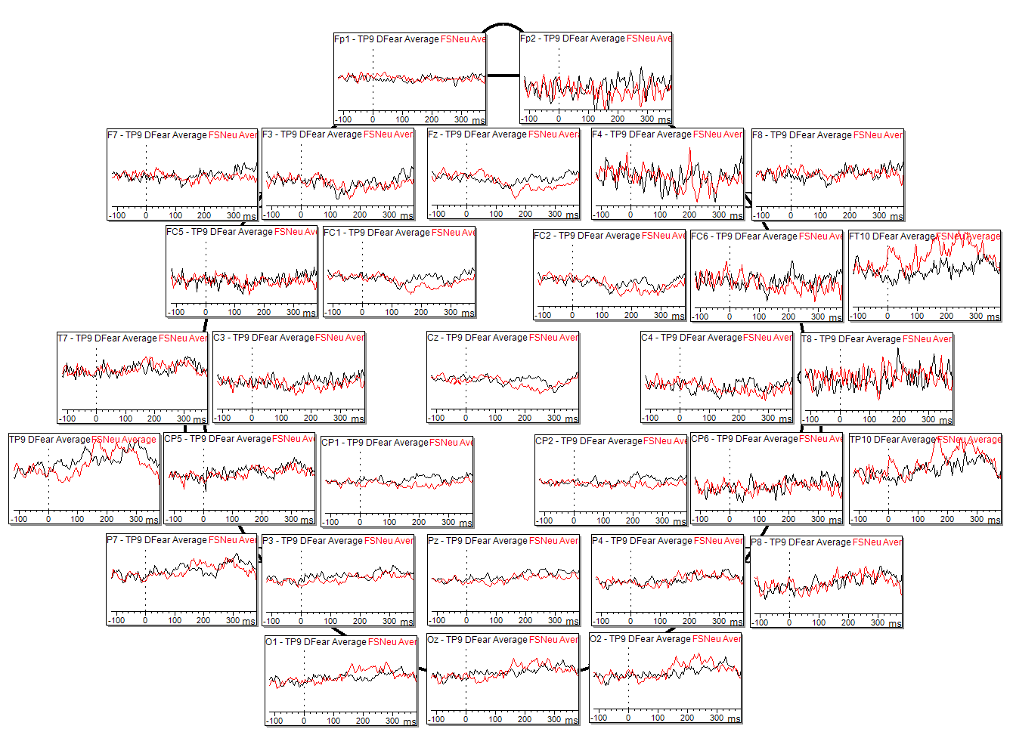
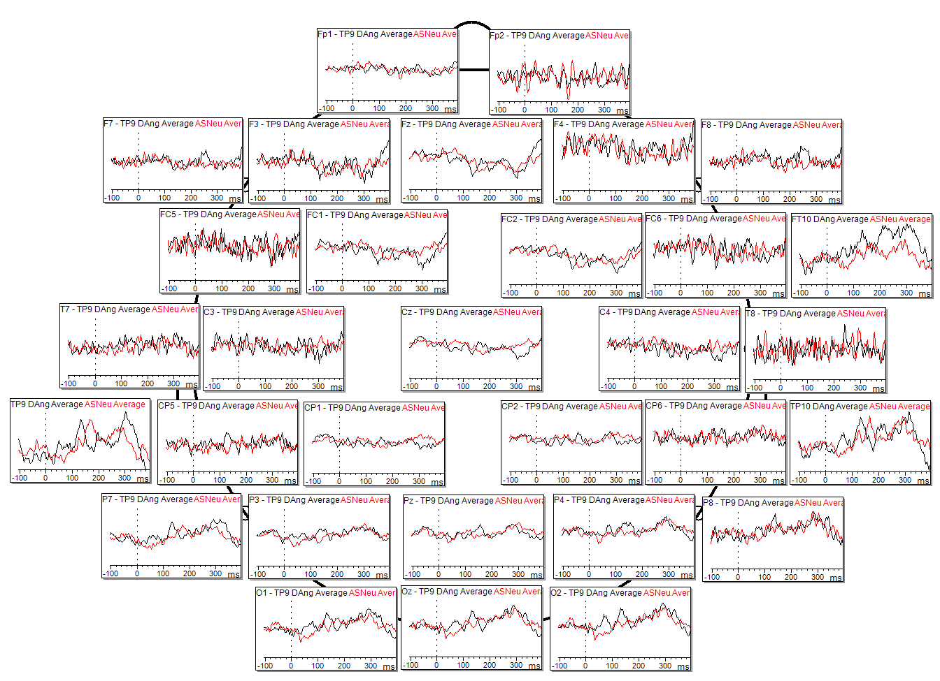
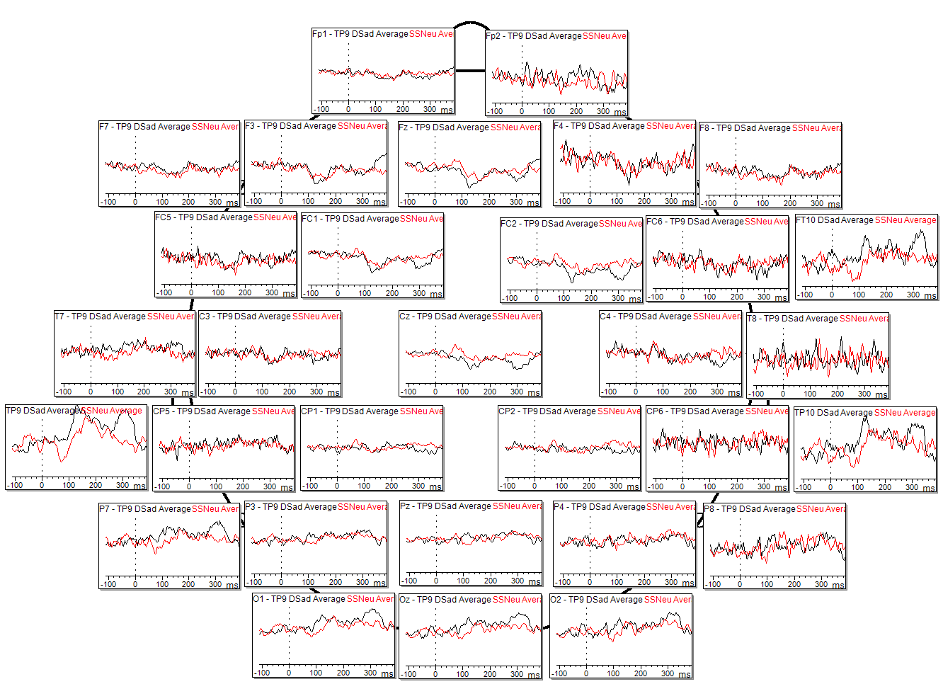
Individual Results – Sub002
Fear Deviant vs Neutral Standard
Angry Deviant vs Neutral Standard
Sad Deviant vs Neutral Standard
Scale: 10µV

Slide 8
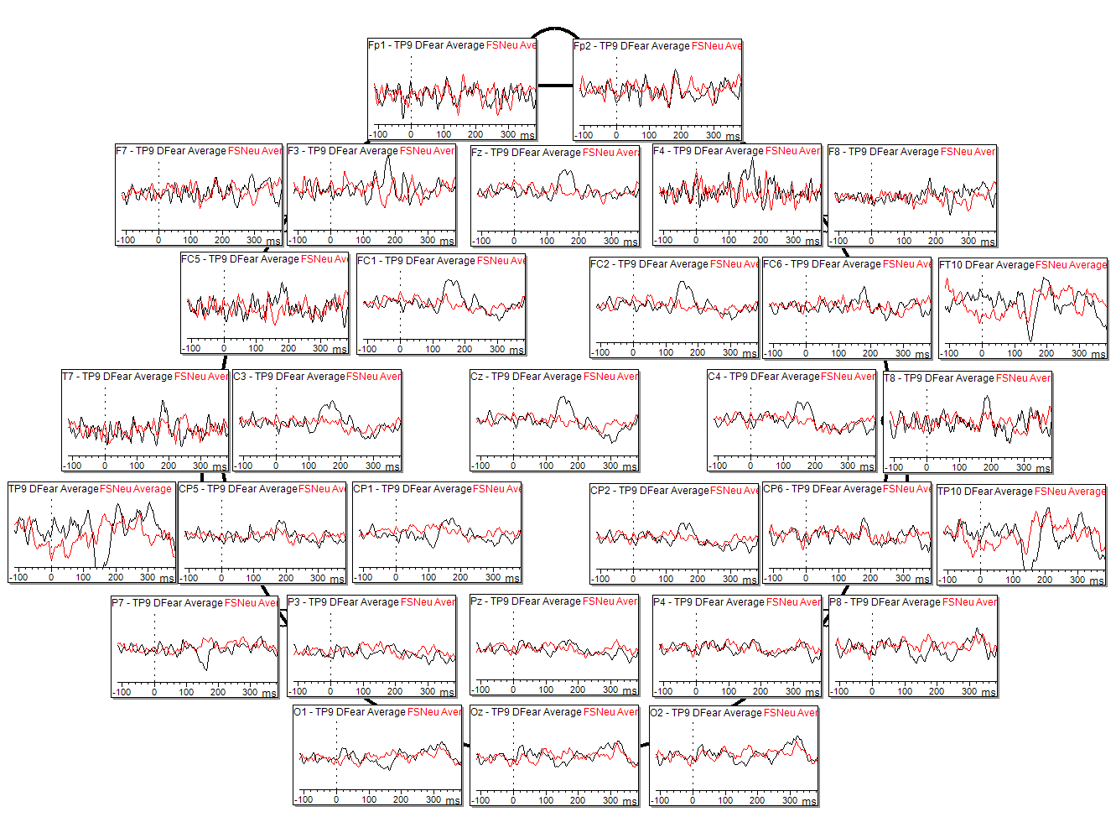
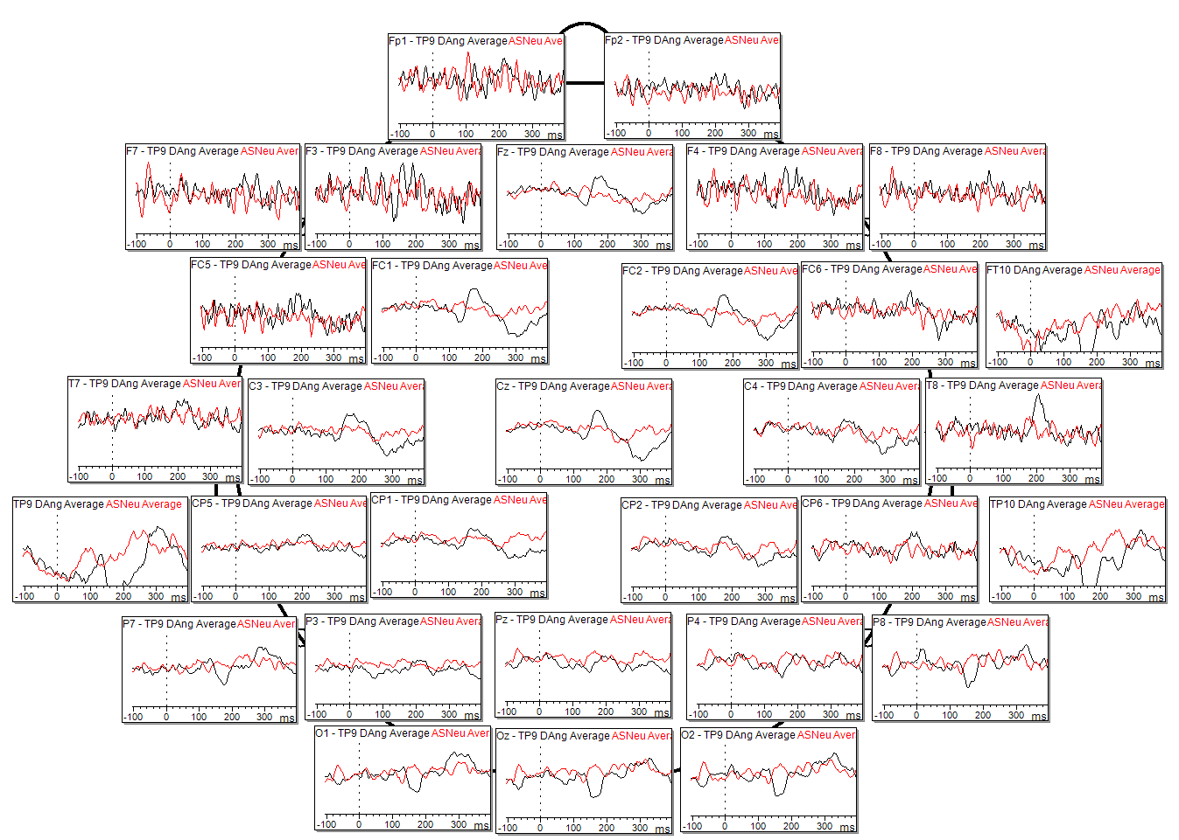
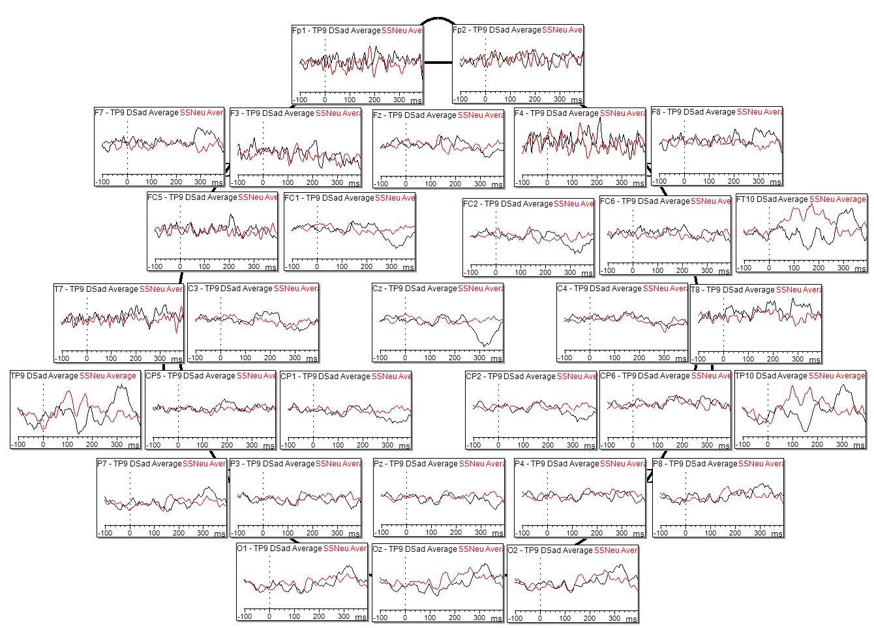
Individual Results – Sub003
Fear Deviant vs Neutral Standard
Sad Deviant vs Neutral Standard
Scale: 10µV

Slide 9
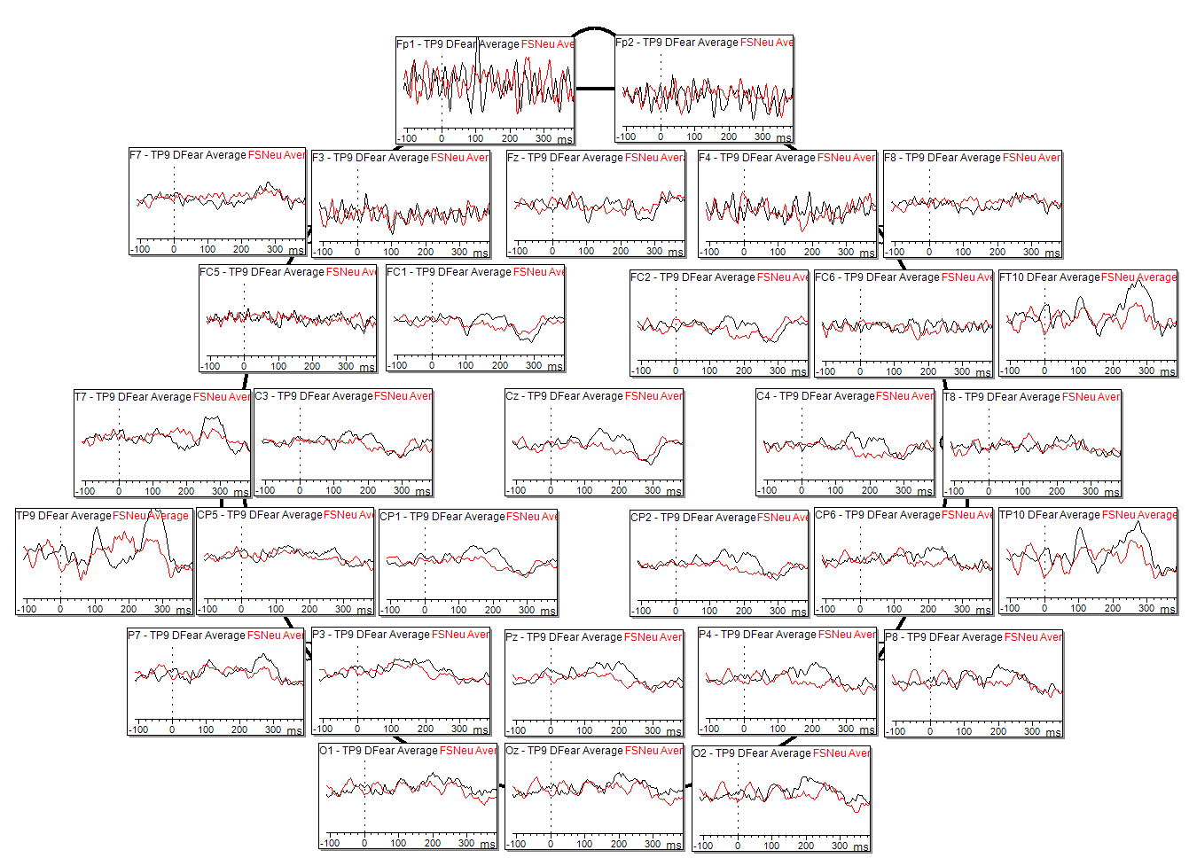
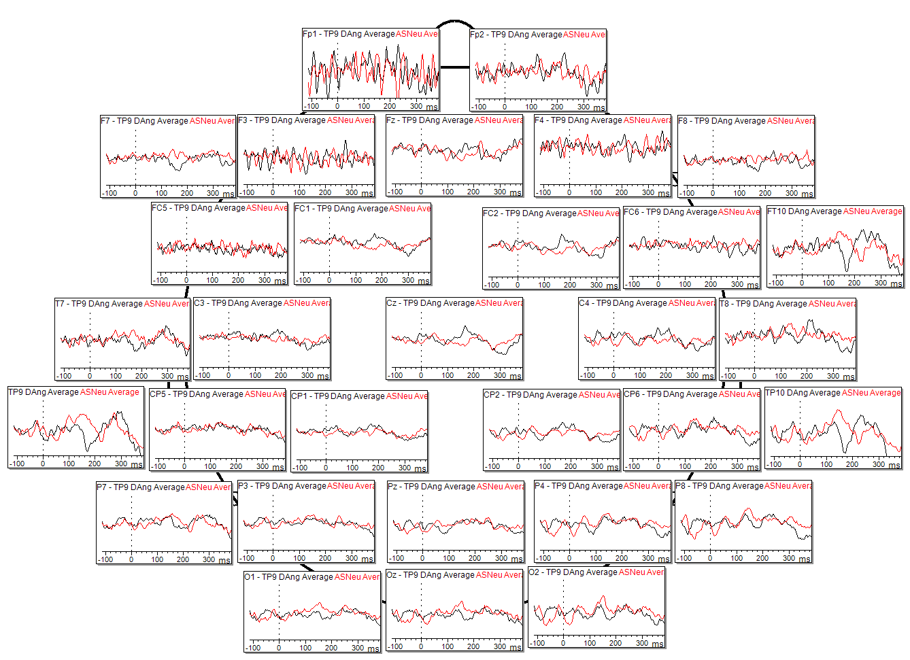
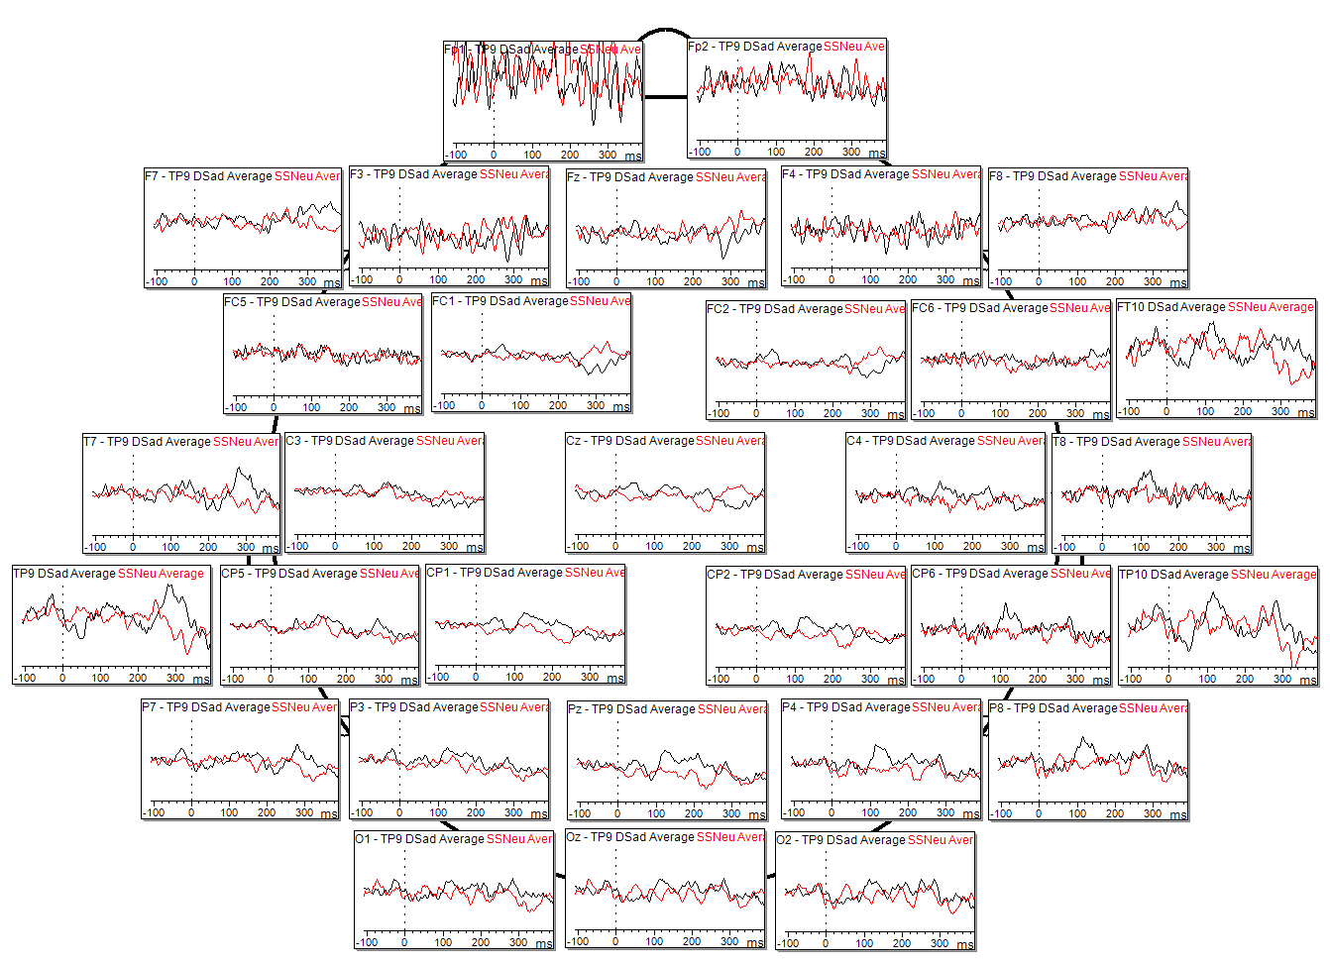
Individual Results – Sub004
Fear Deviant vs Neutral Standard
Angry Deviant vs Neutral Standard
Sad Deviant vs Neutral Standard
Scale: 10µV

Slide 10
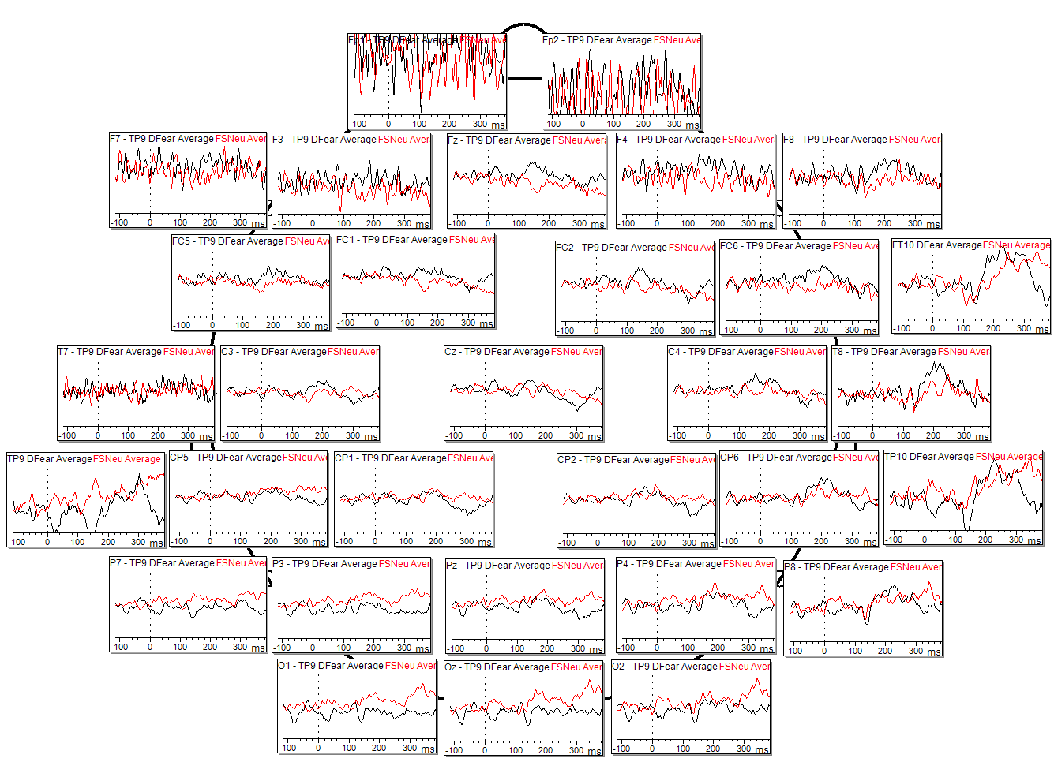
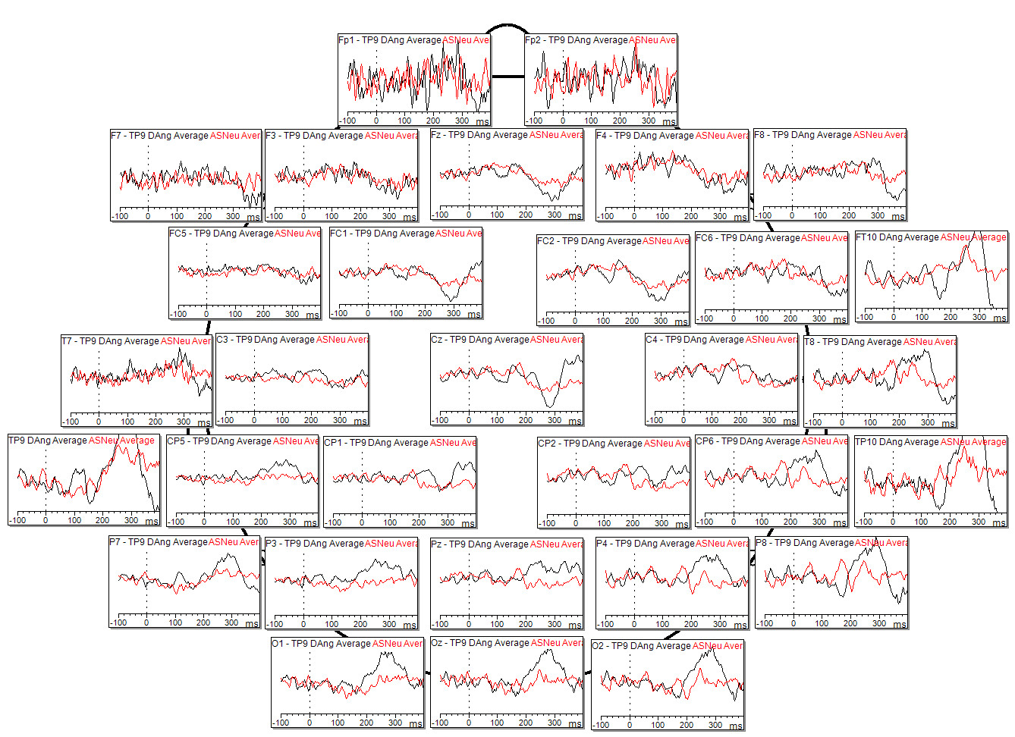
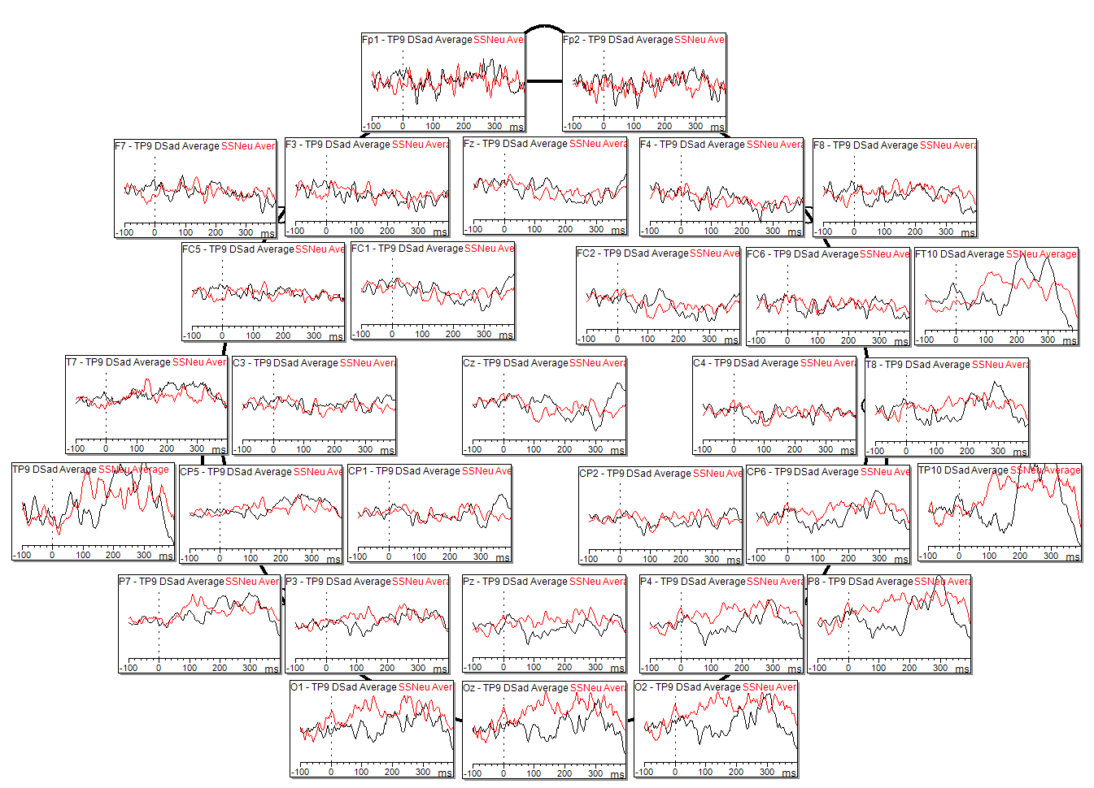
Individual Results – Sub005
Fear Deviant vs Neutral Standard
Angry Deviant vs Neutral Standard
Sad Deviant vs Neutral Standard
Scale: 10µV

Slide 11
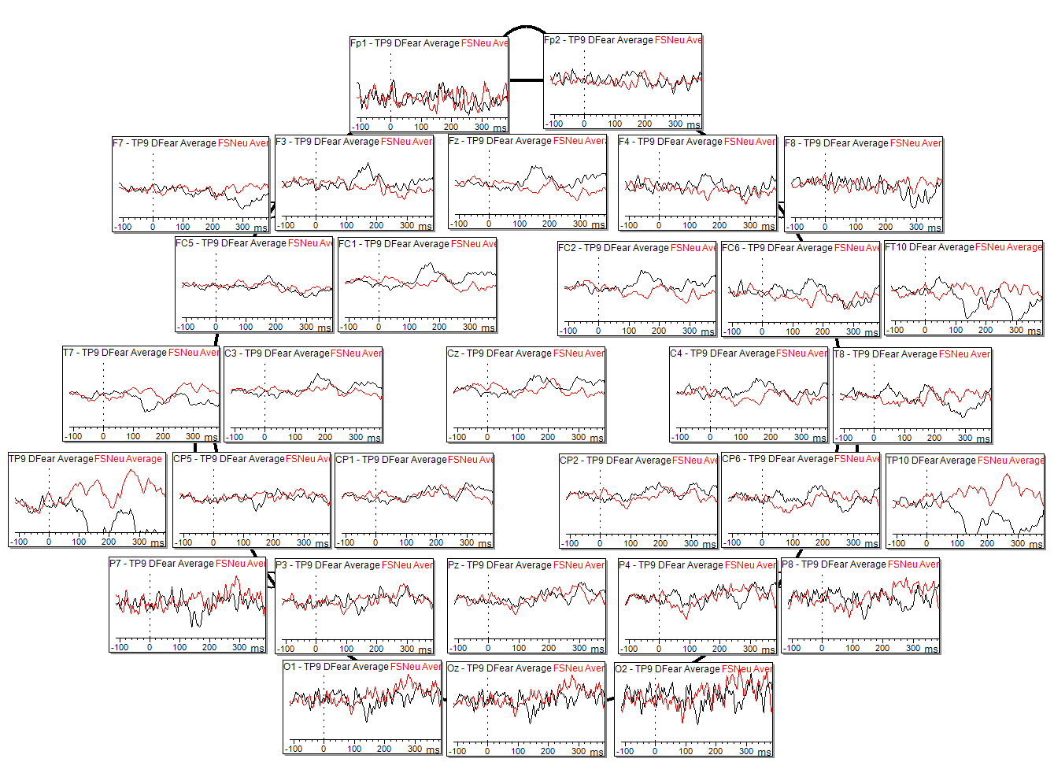
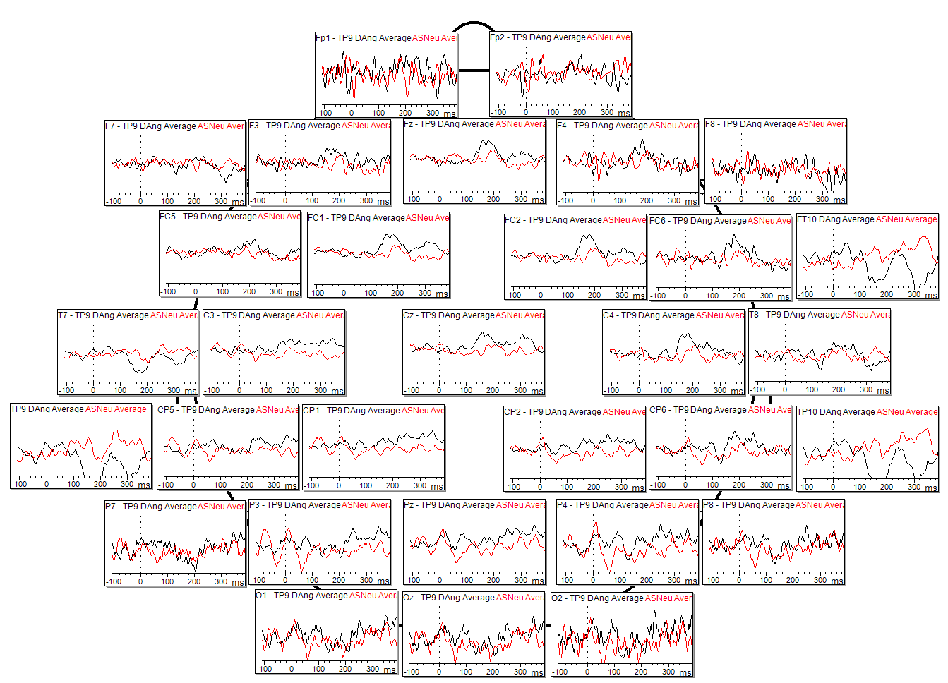
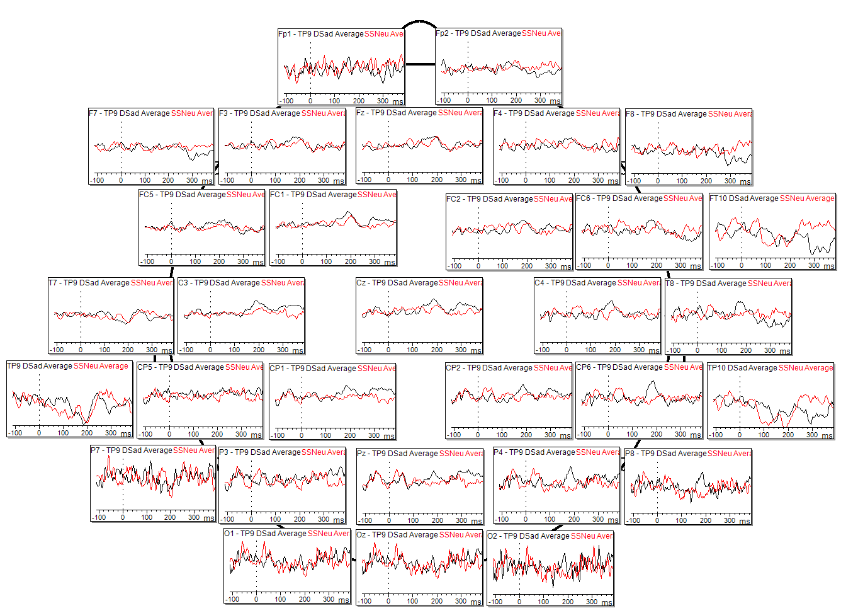
Individual Results – Sub006
Fear Deviant vs Neutral Standard
Angry Deviant vs Neutral Standard
Sad Deviant vs Neutral Standard
Scale: 10µV

Slide 12
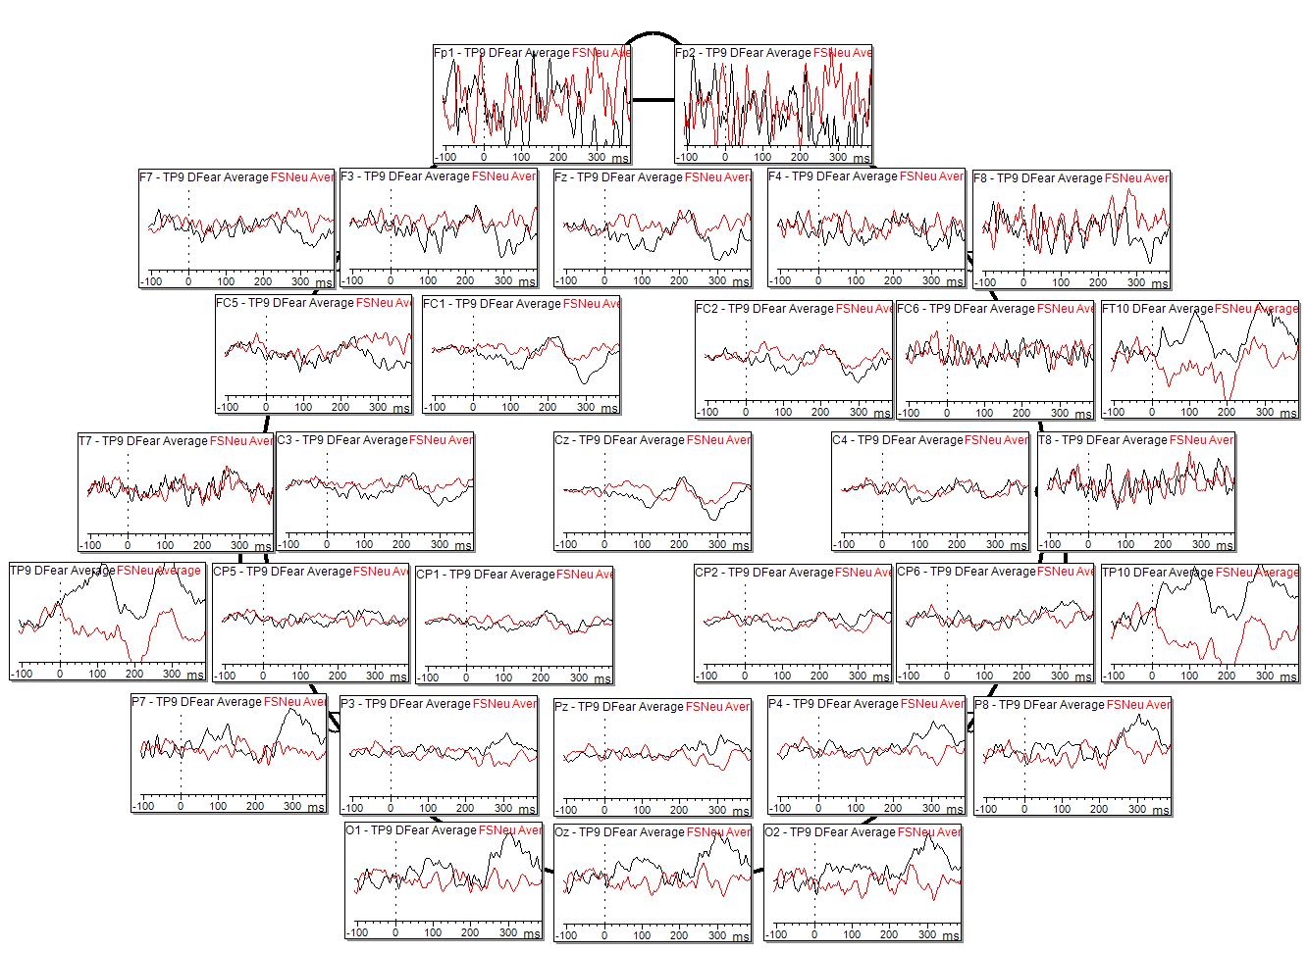
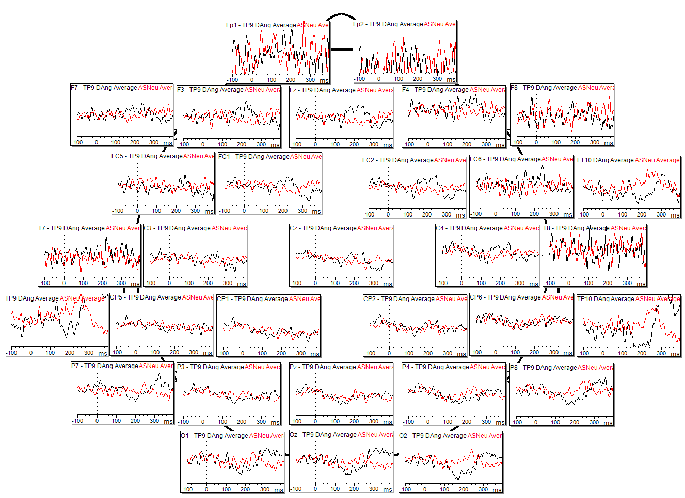
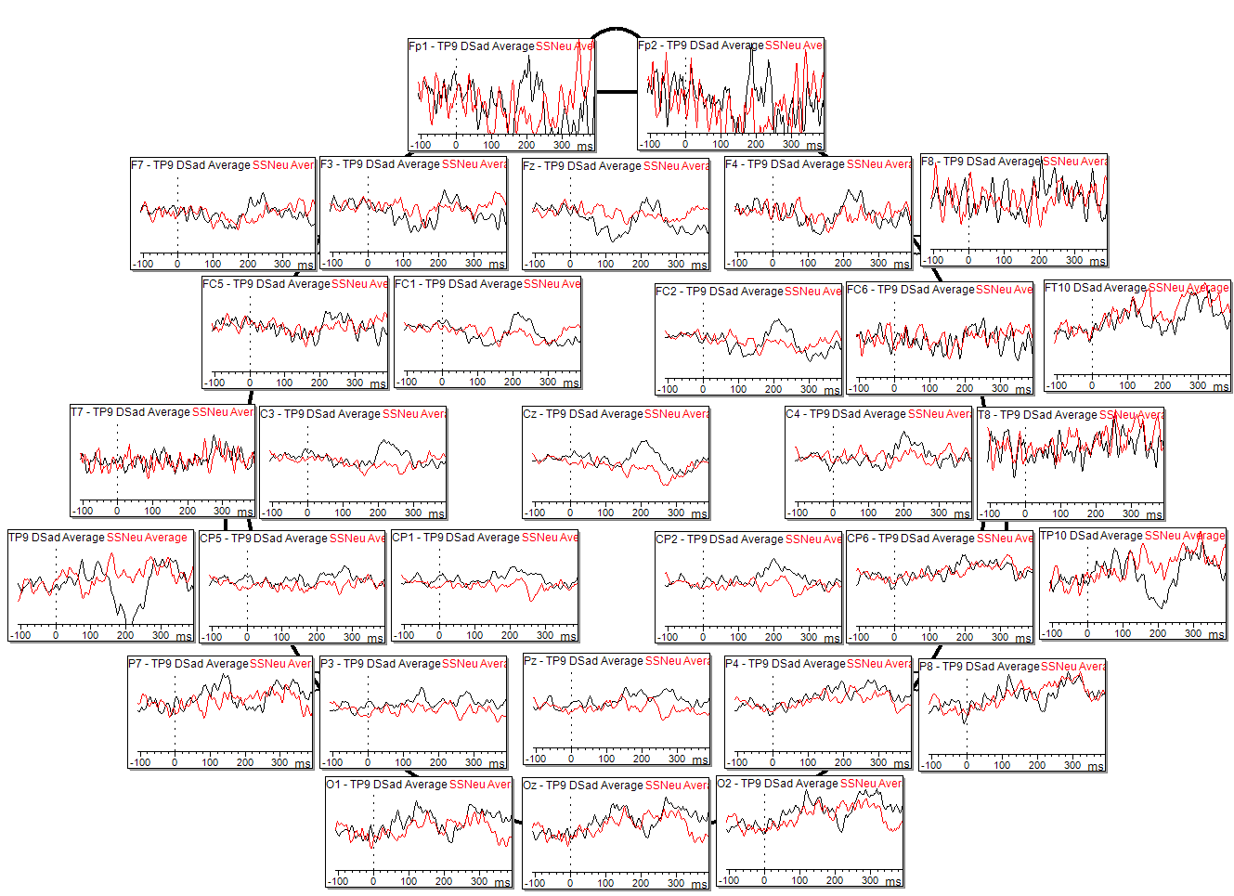
Individual Results – Sub007
Fear Deviant vs Neutral Standard
Angry Deviant vs Neutral Standard
Sad Deviant vs Neutral Standard
Scale: 10µV

Slide 13
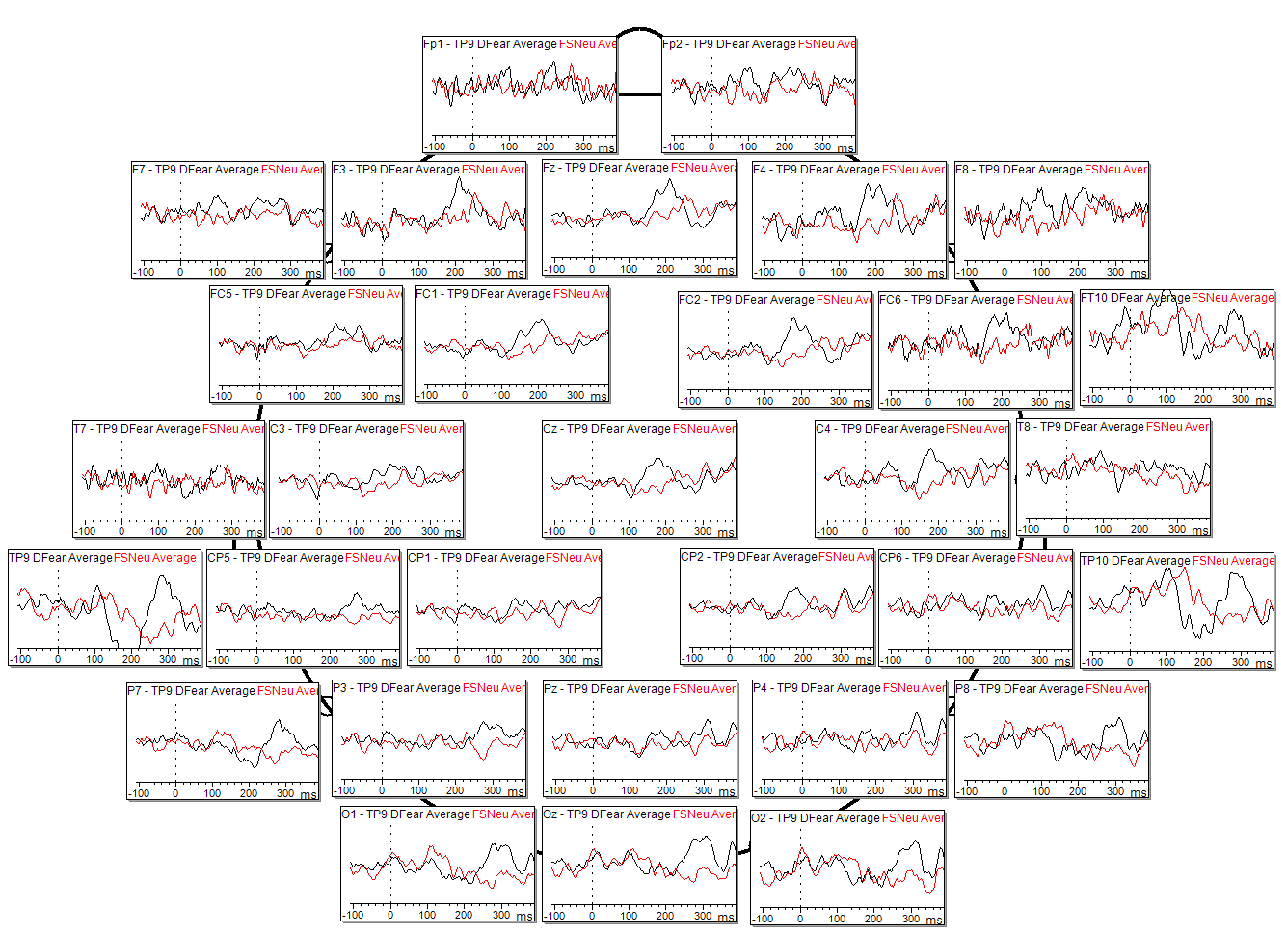
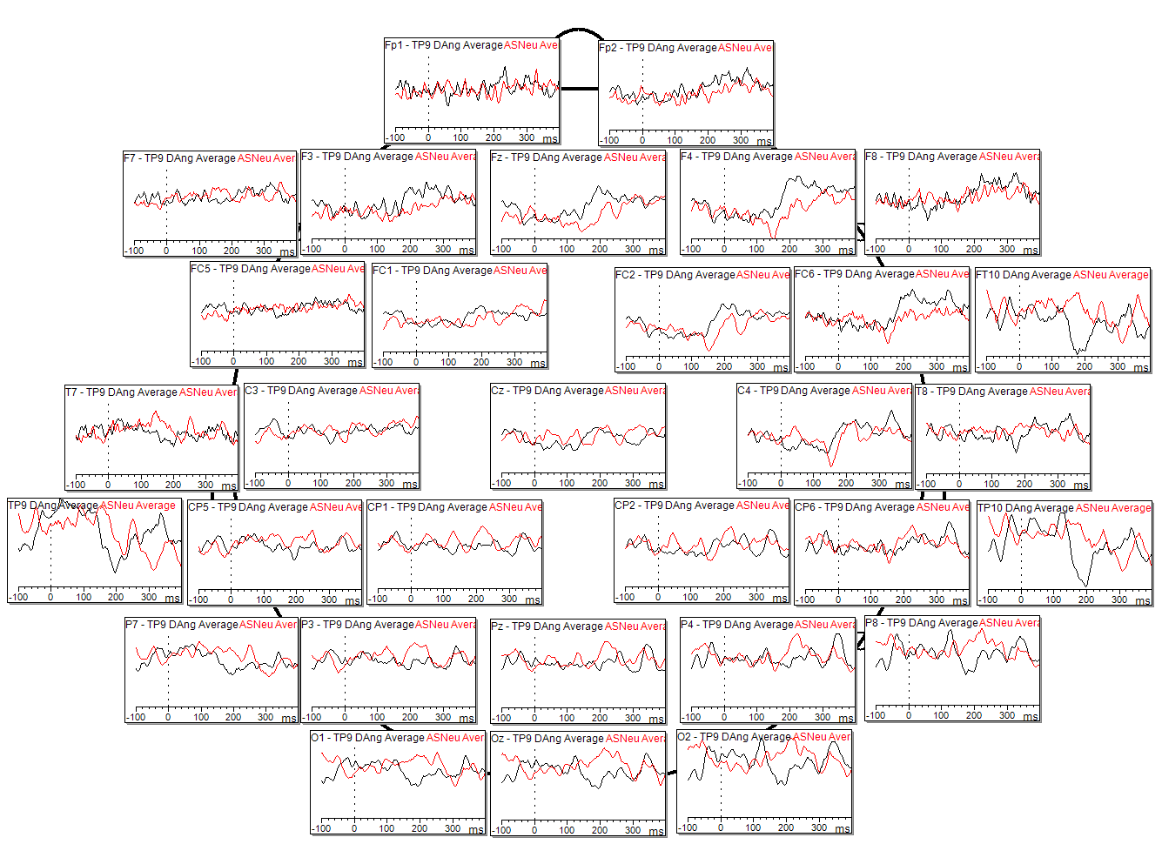
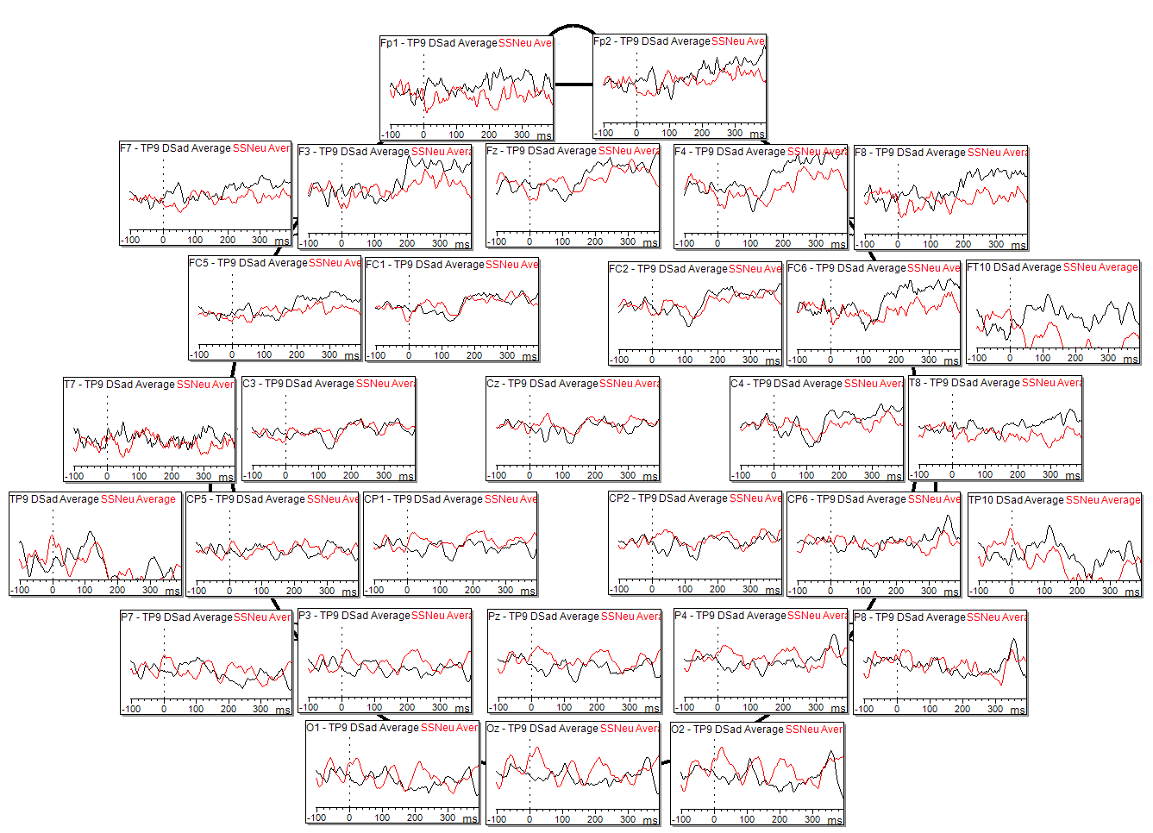
Individual Results – Sub008
Fear Deviant vs Neutral Standard
Angry Deviant vs Neutral Standard
Sad Deviant vs Neutral Standard
Scale: 10µV

Slide 14
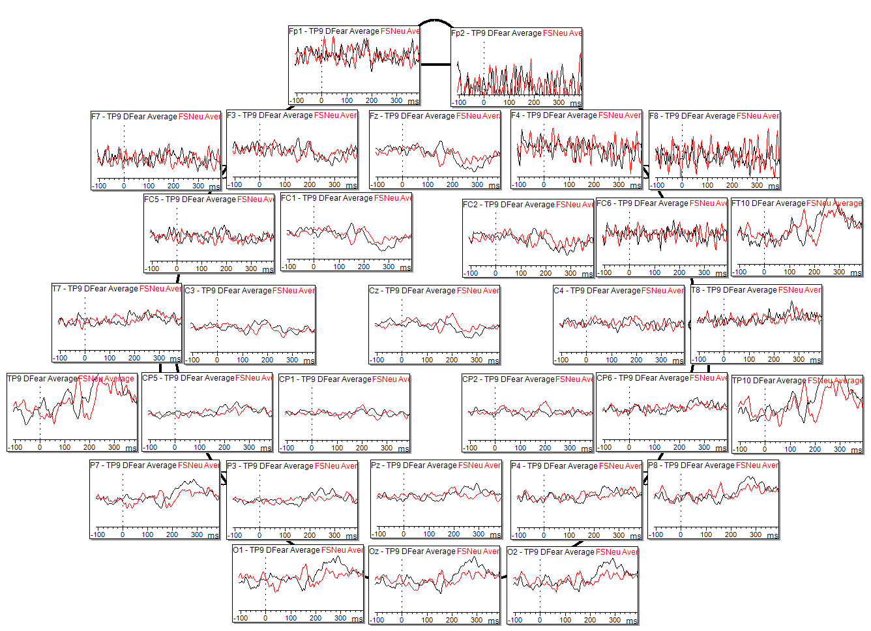
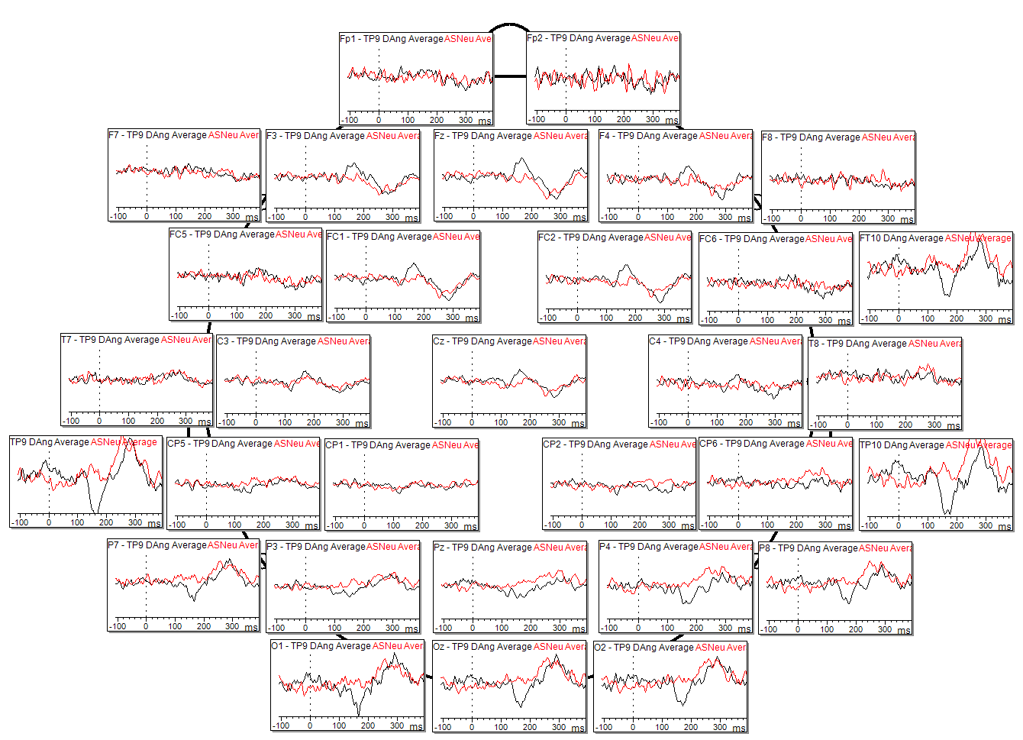
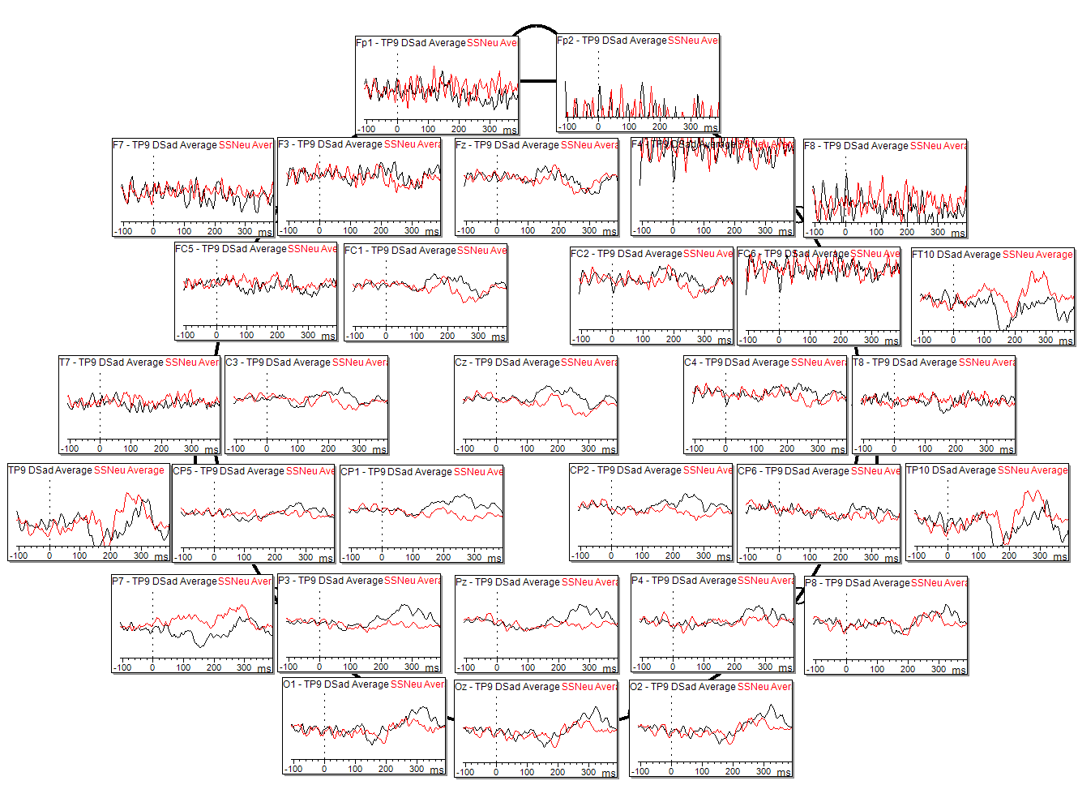
Individual Results – Sub009
Fear Deviant vs Neutral Standard
Angry Deviant vs Neutral Standard
Sad Deviant vs Neutral Standard
Scale: 10µV

Slide 15
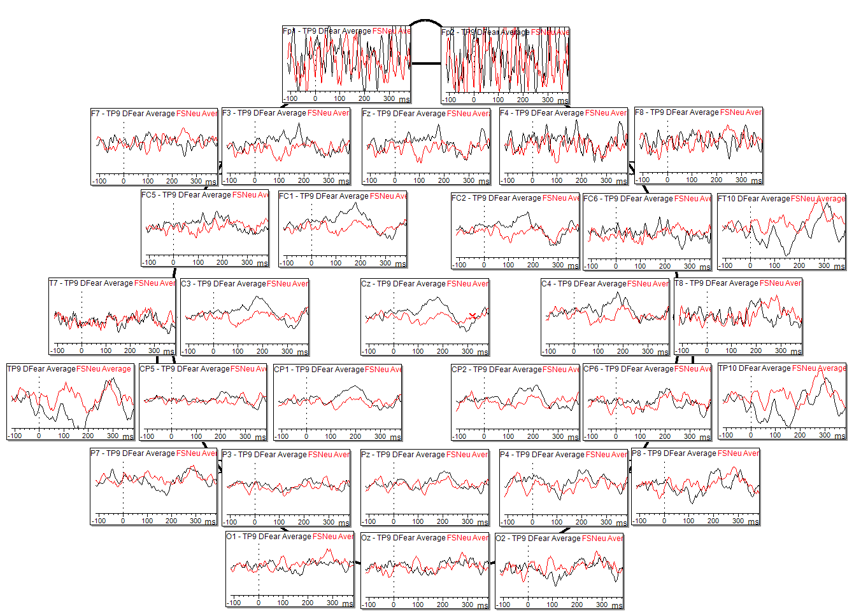
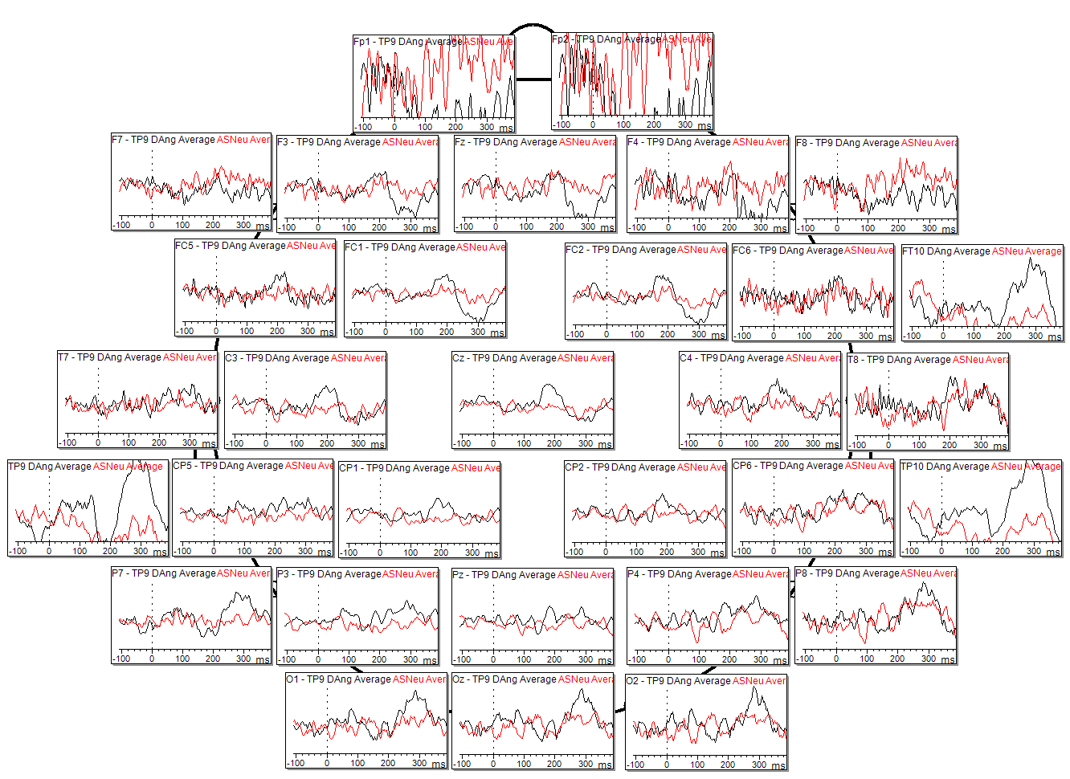
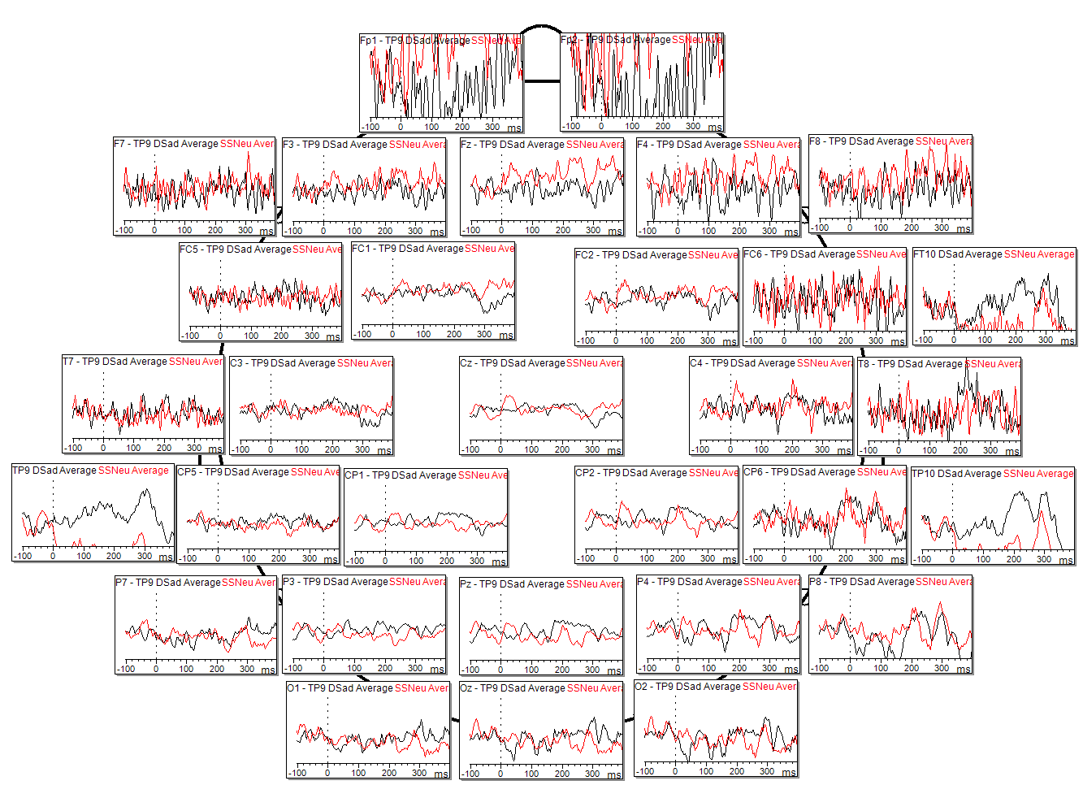
Individual Results – Sub010
Fear Deviant vs Neutral Standard
Angry Deviant vs Neutral Standard
Sad Deviant vs Neutral Standard
Scale: 10µV

Slide 16
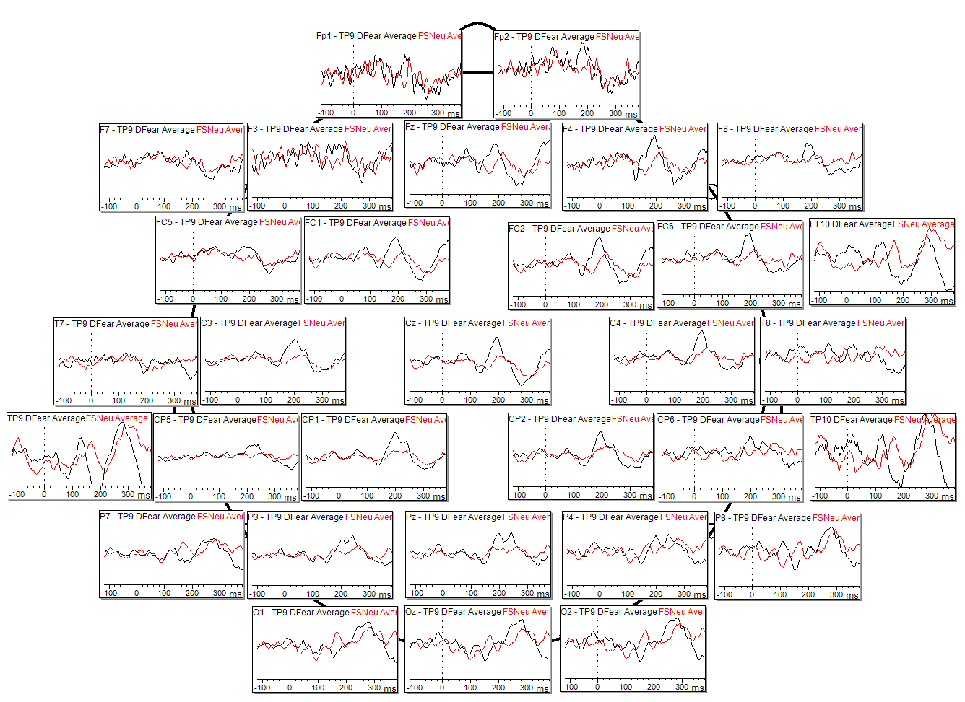
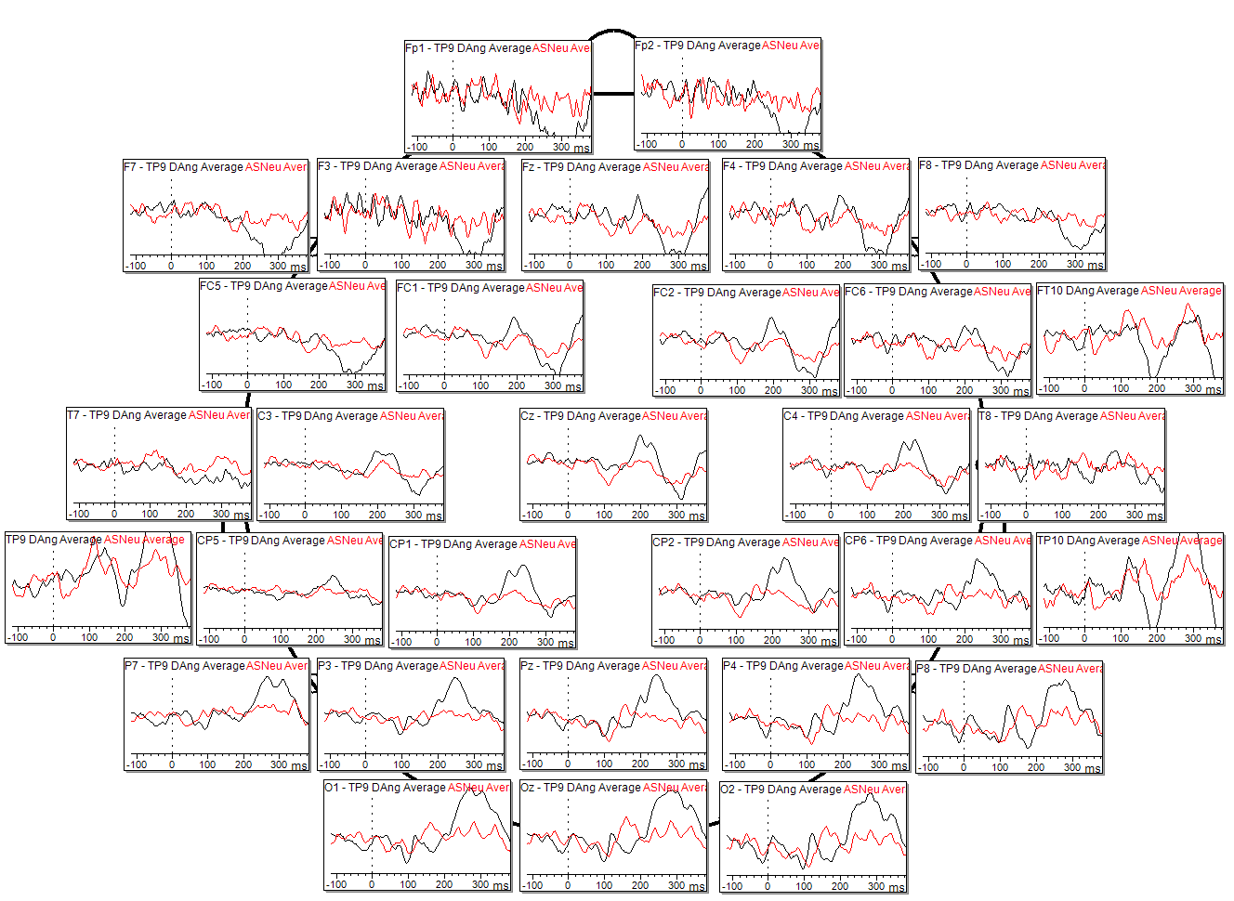
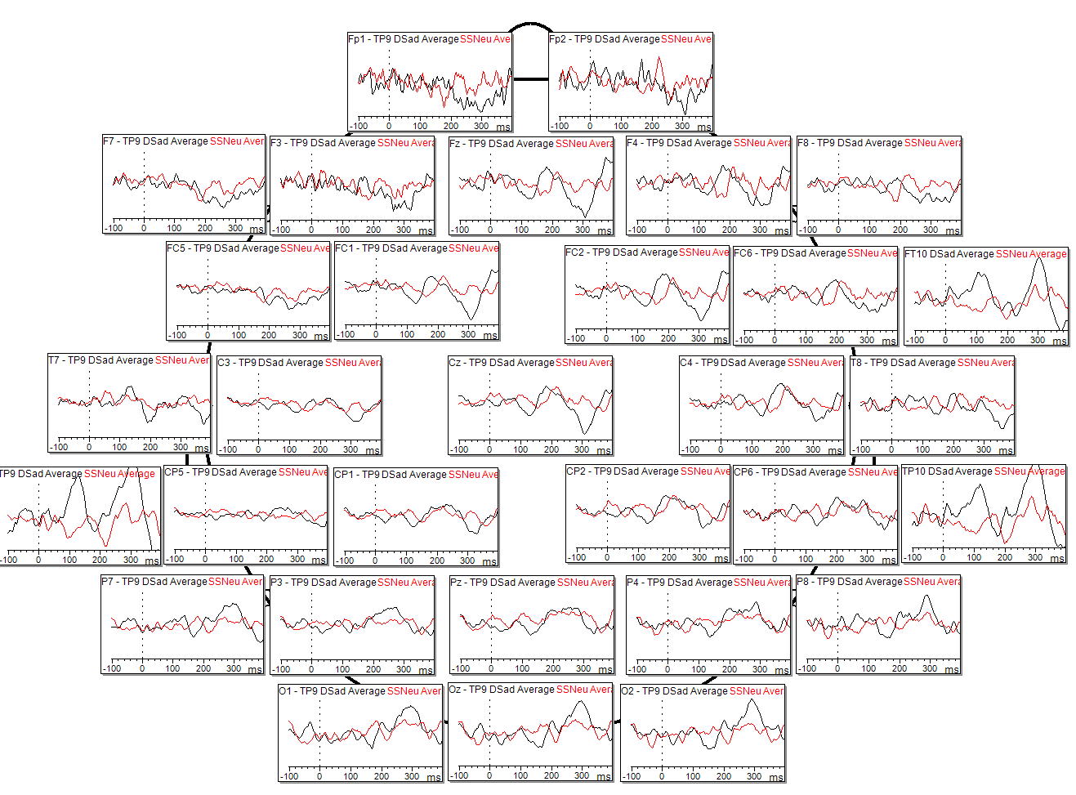
Individual Results – Sub011
Fear Deviant vs Neutral Standard
Angry Deviant vs Neutral Standard
Sad Deviant vs Neutral Standard
Scale: 10µV

Slide 17
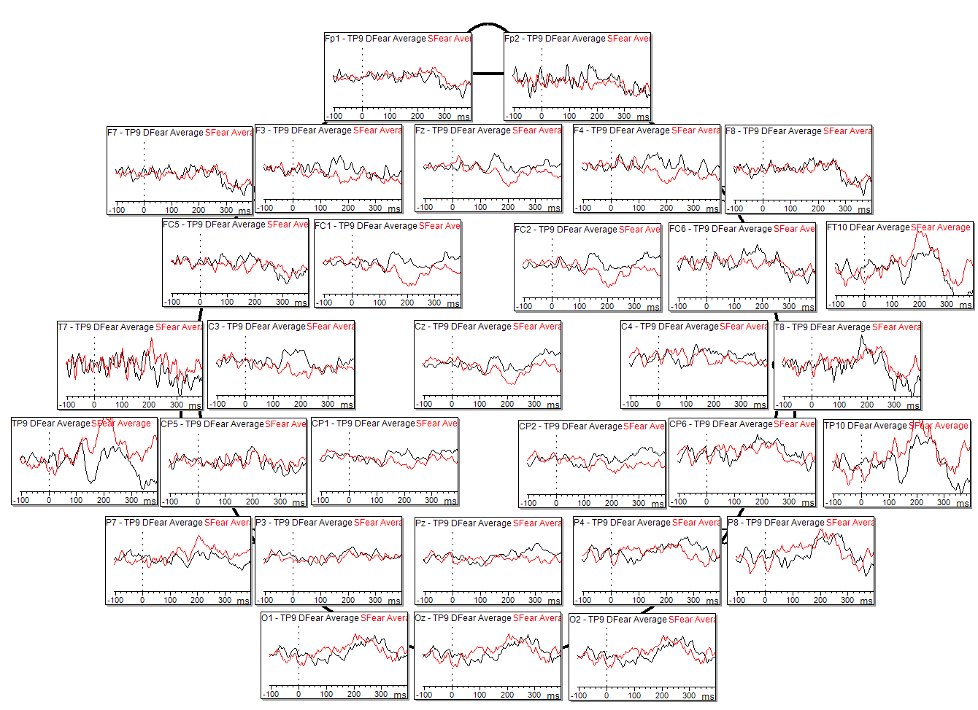
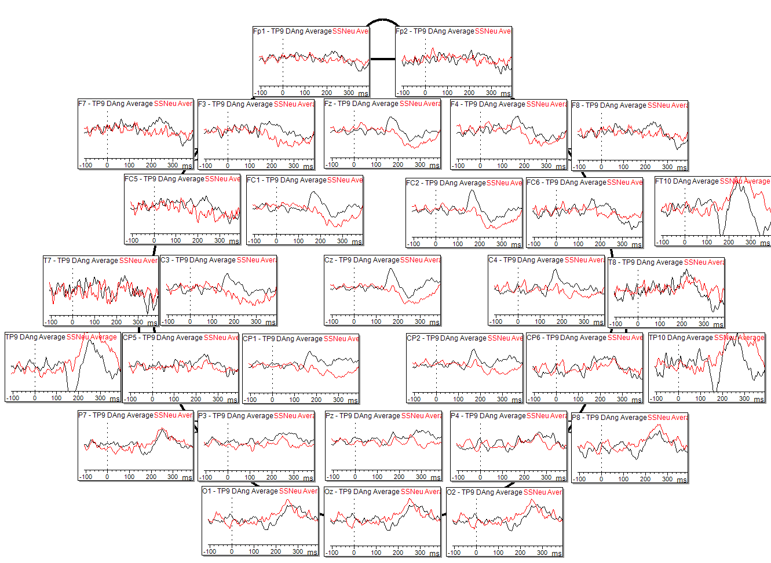
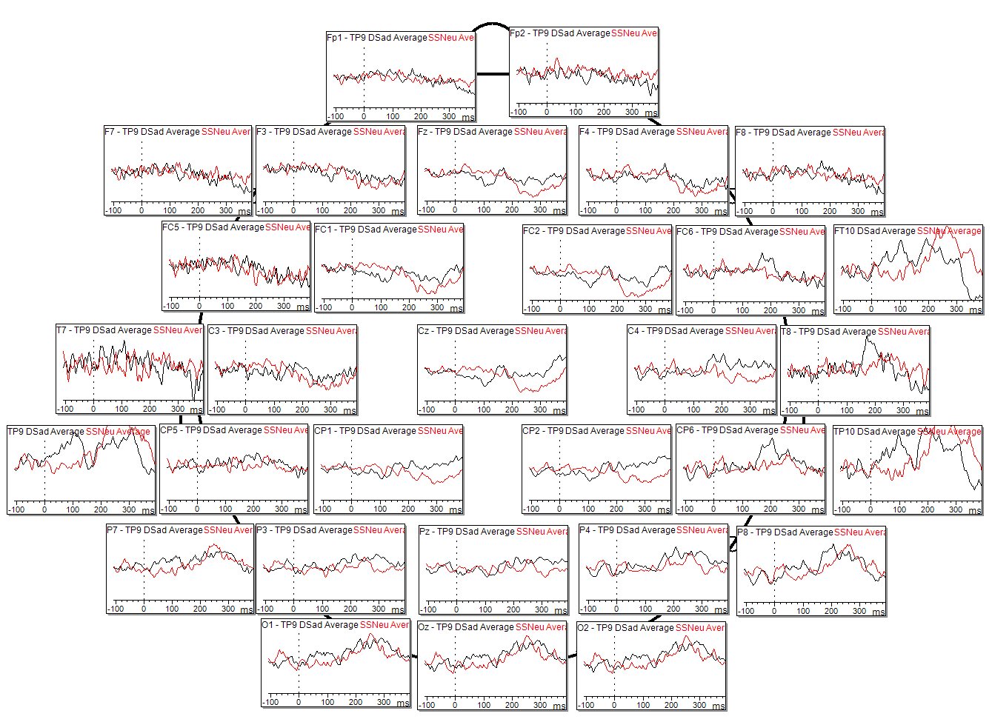
Individual Results – Sub012
Fear Deviant vs Neutral Standard
Angry Deviant vs Neutral Standard
Sad Deviant vs Neutral Standard
Scale: 10µV

Slide 18
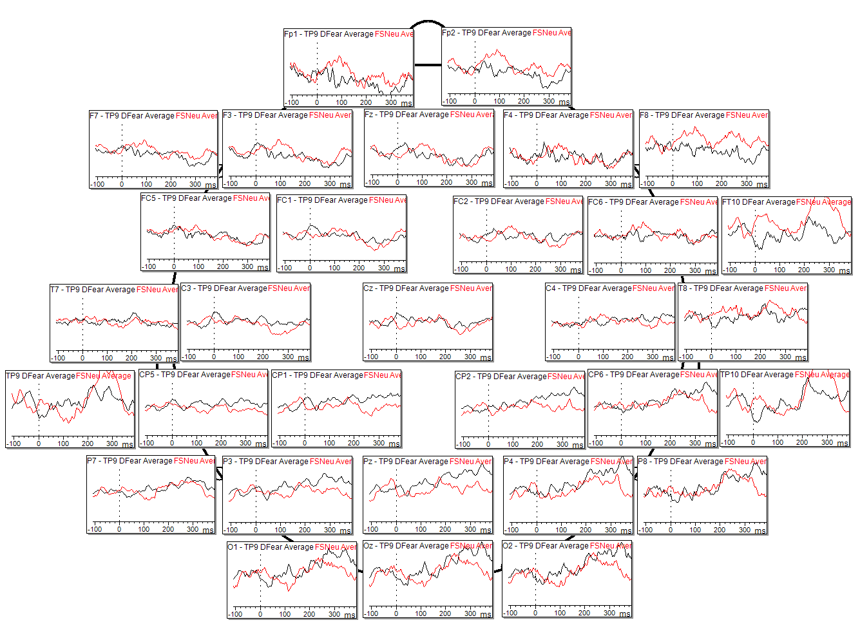
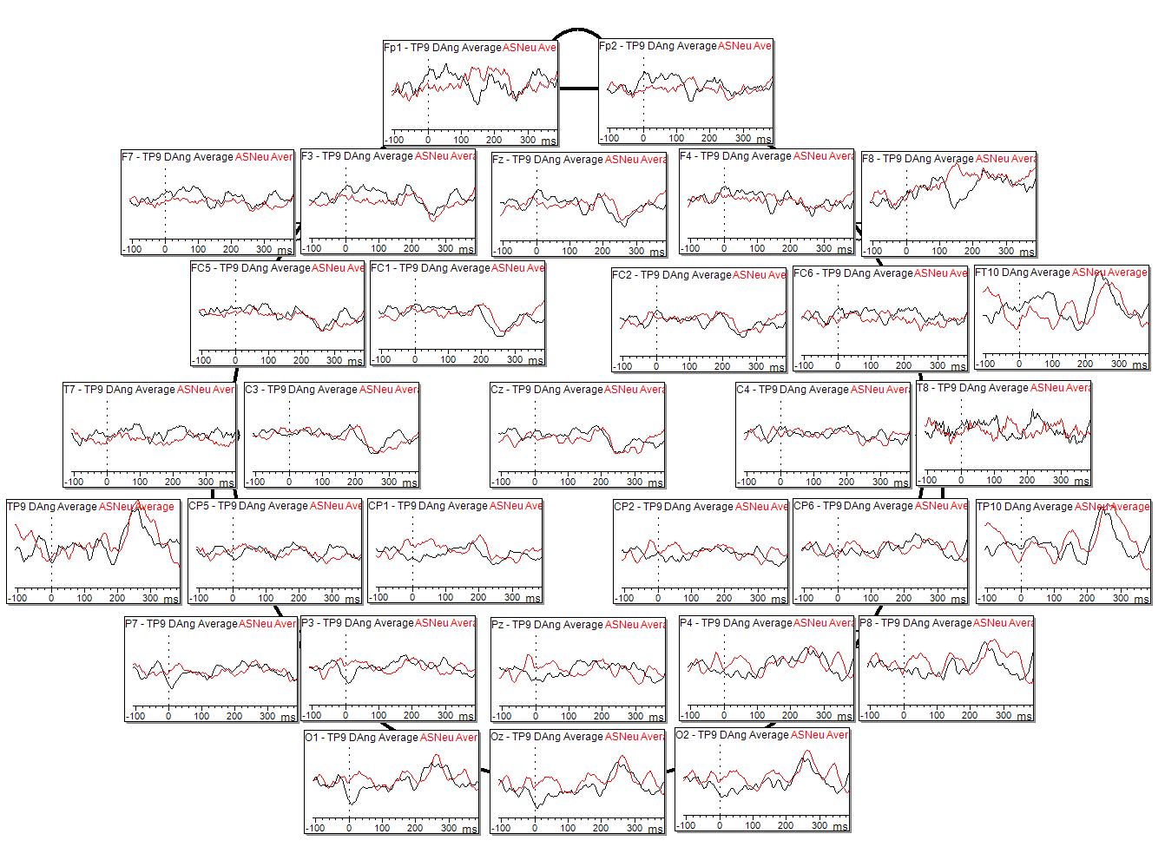
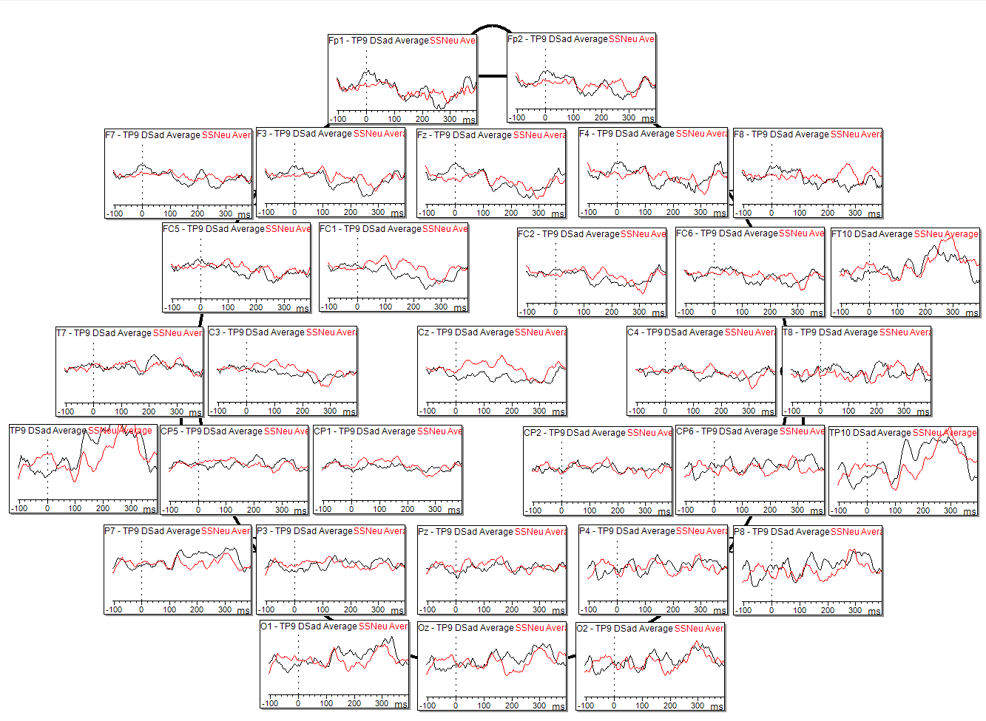
Individual Results – Sub013
Fear Deviant vs Neutral Standard
Angry Deviant vs Neutral Standard
Sad Deviant vs Neutral Standard
Scale: 10µV

Slide 19
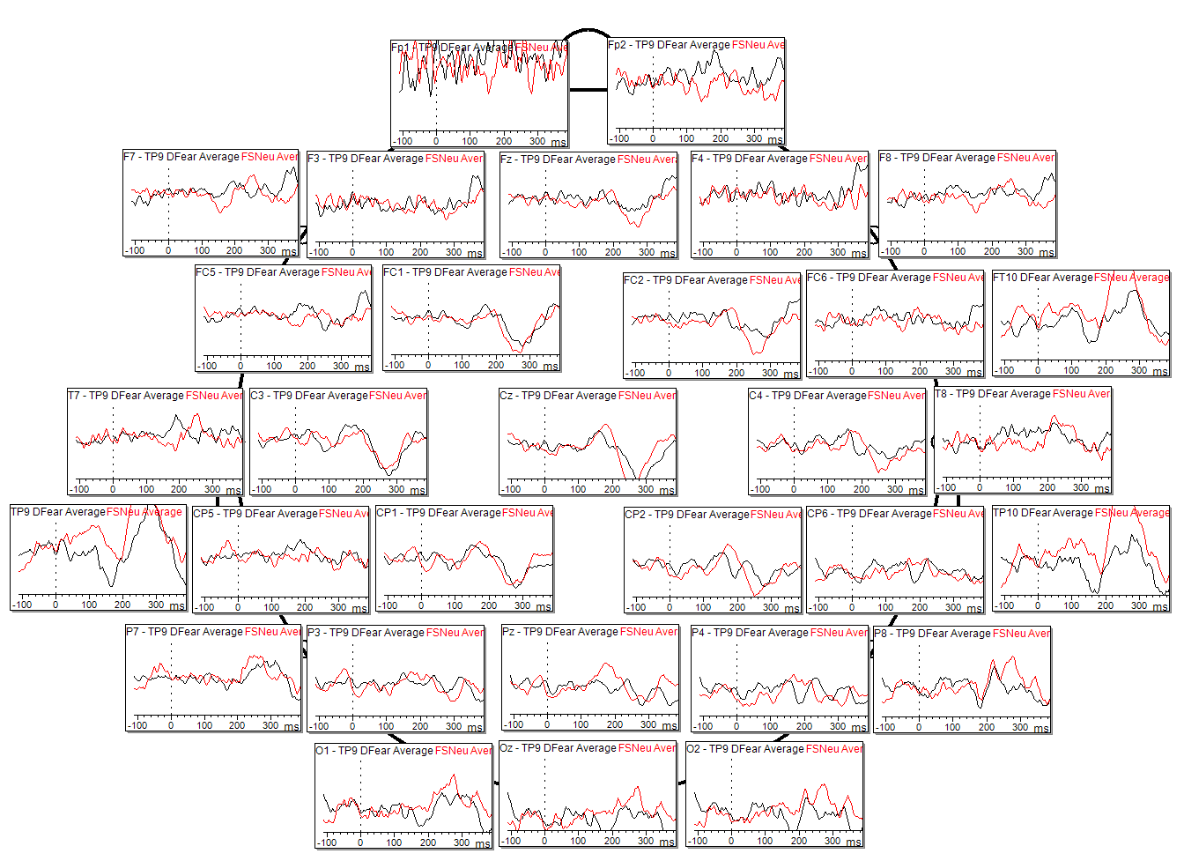
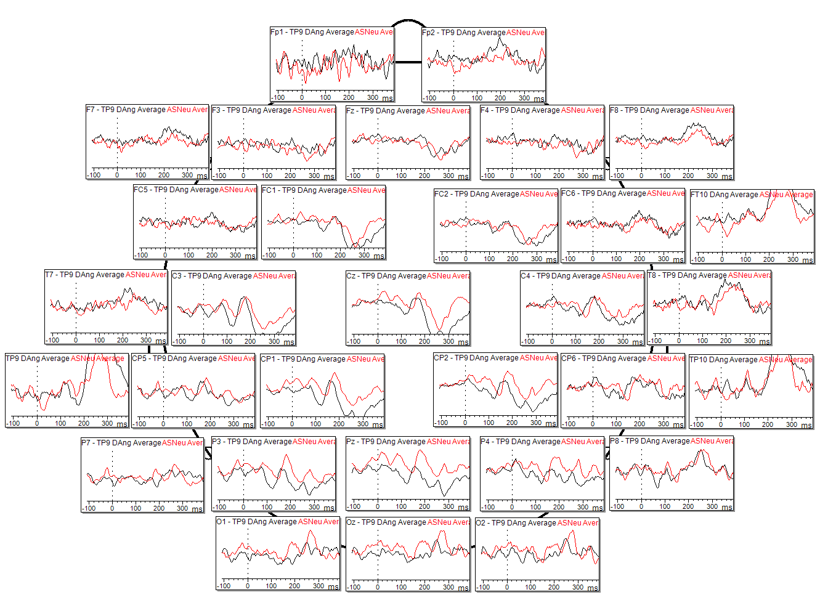
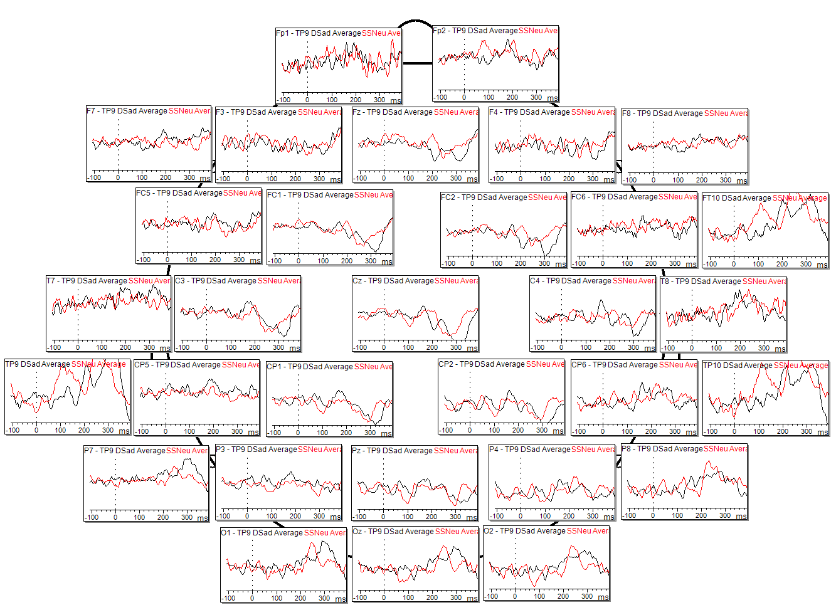
Individual Results – Sub014
Fear Deviant vs Neutral Standard
Angry Deviant vs Neutral Standard
Sad Deviant vs Neutral Standard
Scale: 10µV

Slide 20
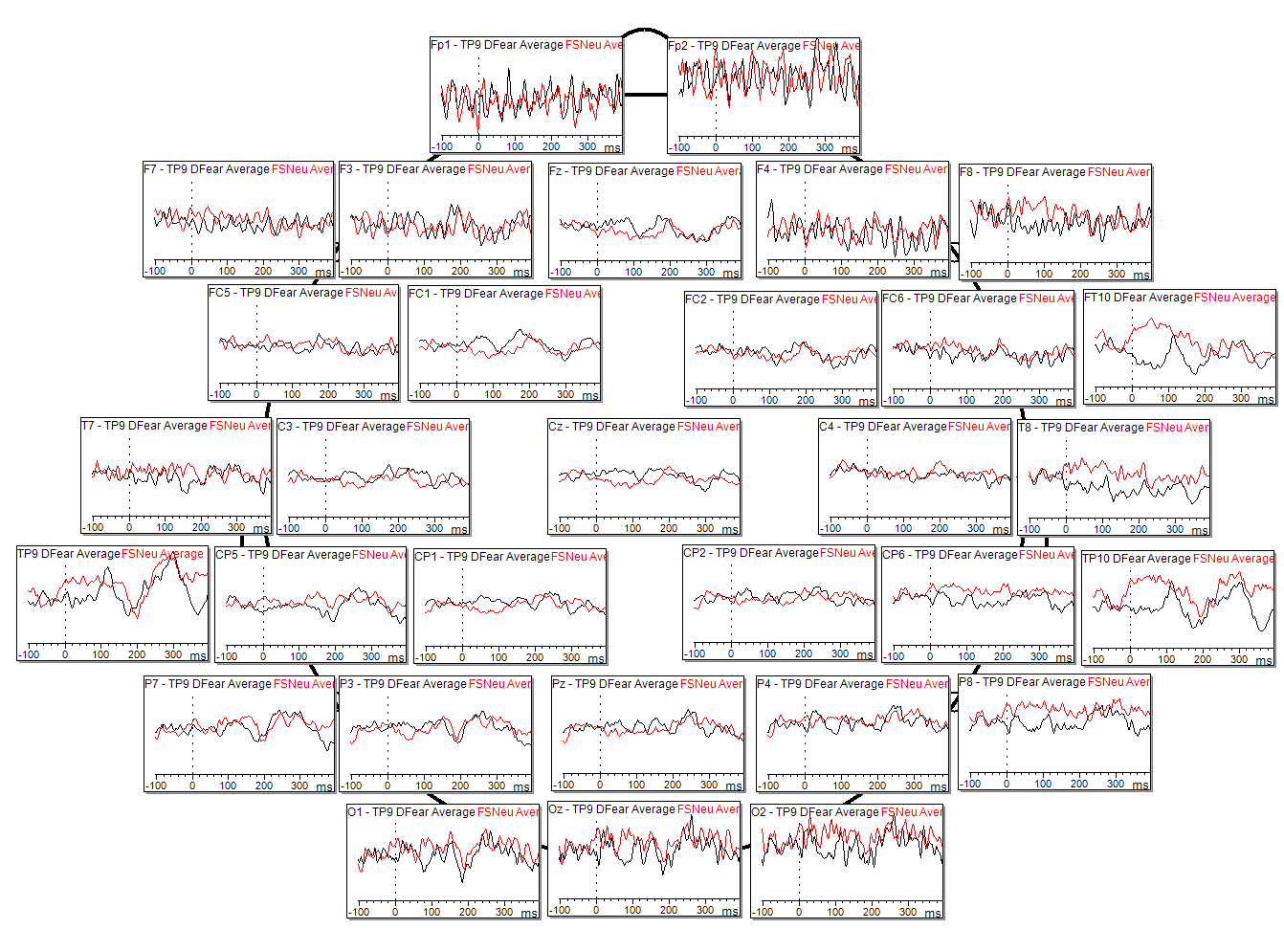
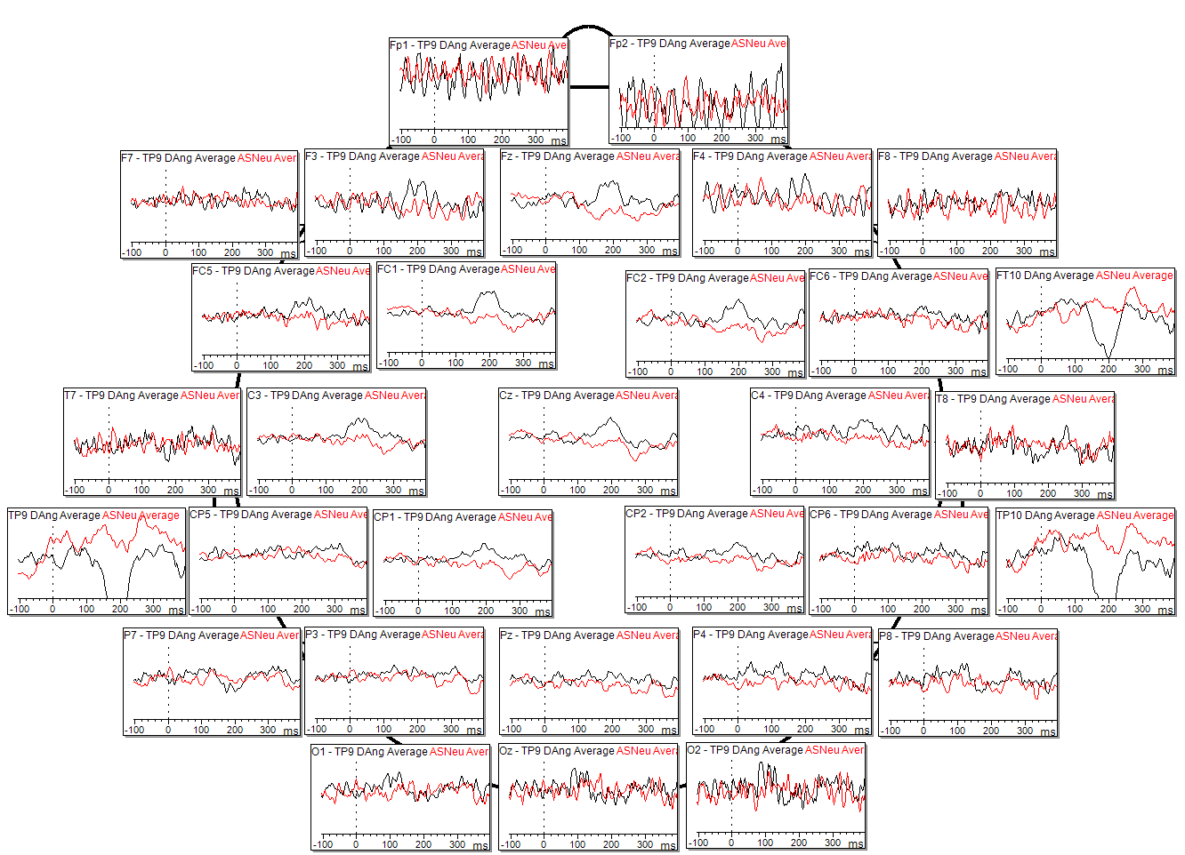
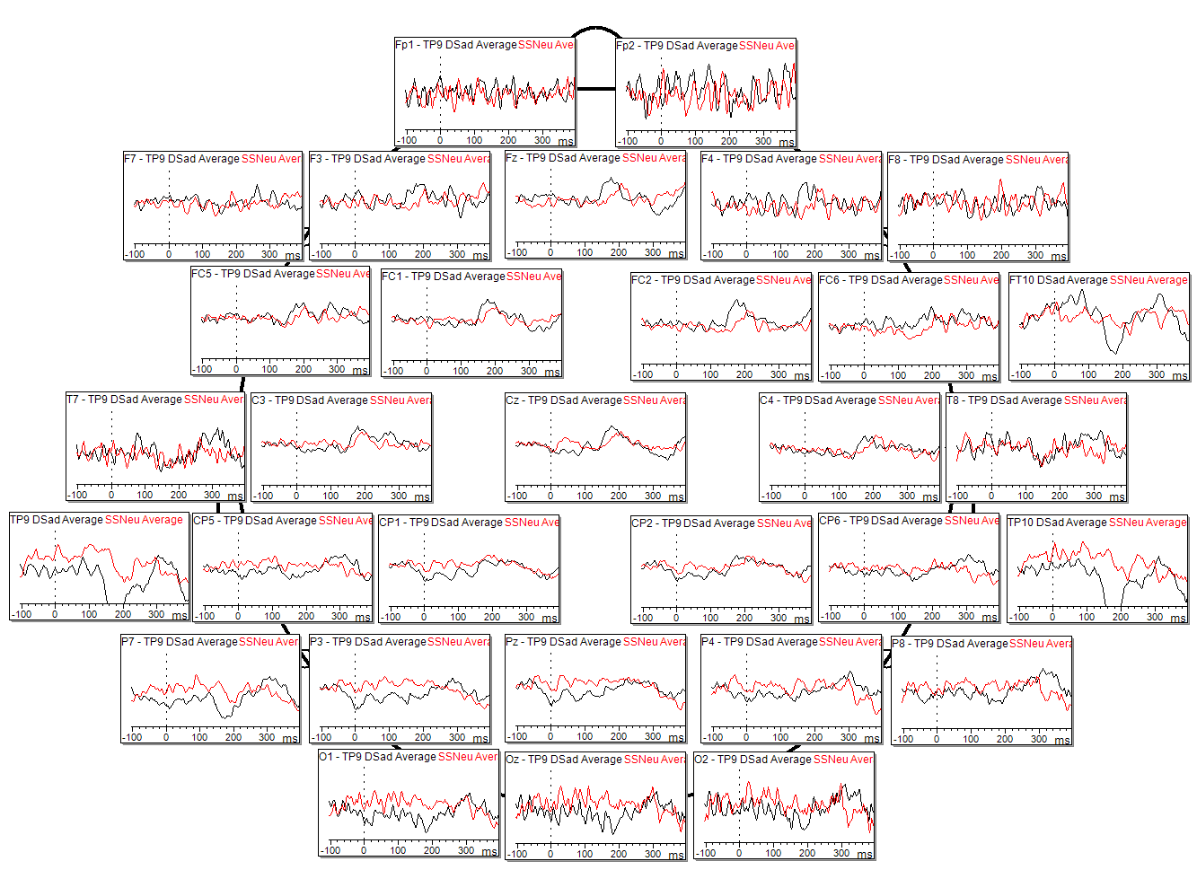
Individual Results – Sub015
Fear Deviant vs Neutral Standard
Angry Deviant vs Neutral Standard
Sad Deviant vs Neutral Standard
Scale: 10µV

Slide 21
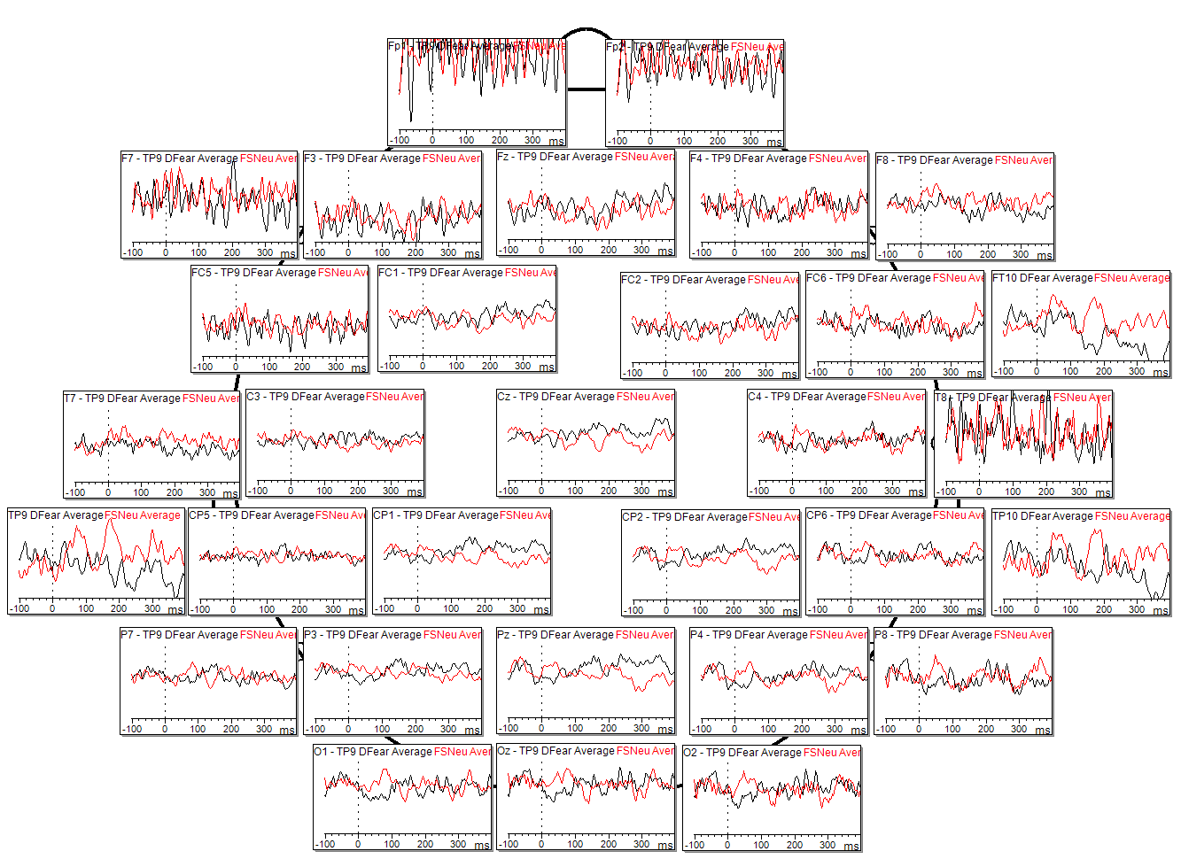
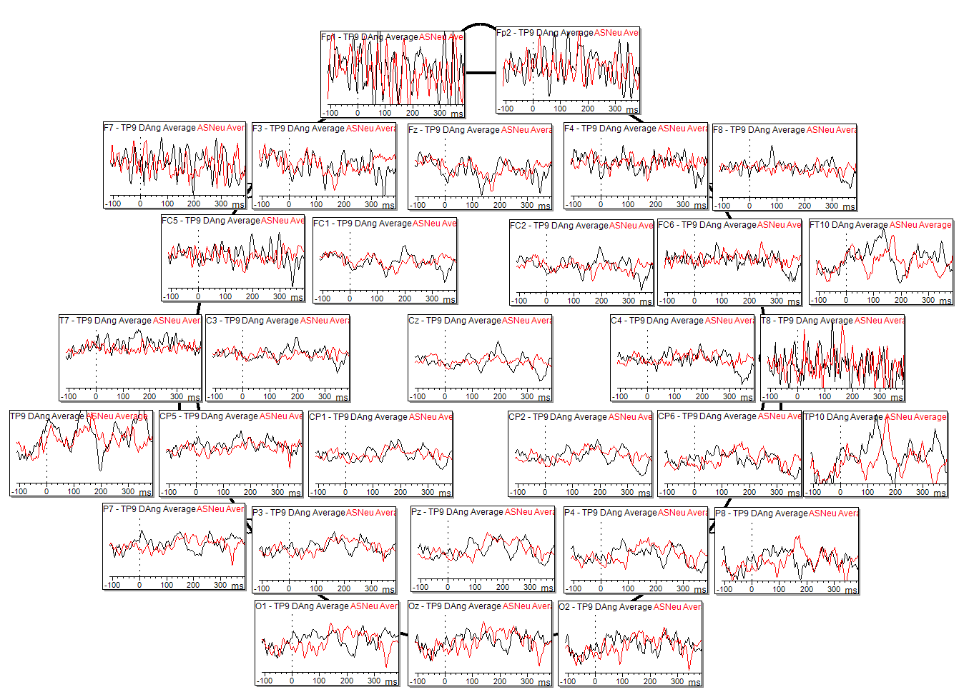
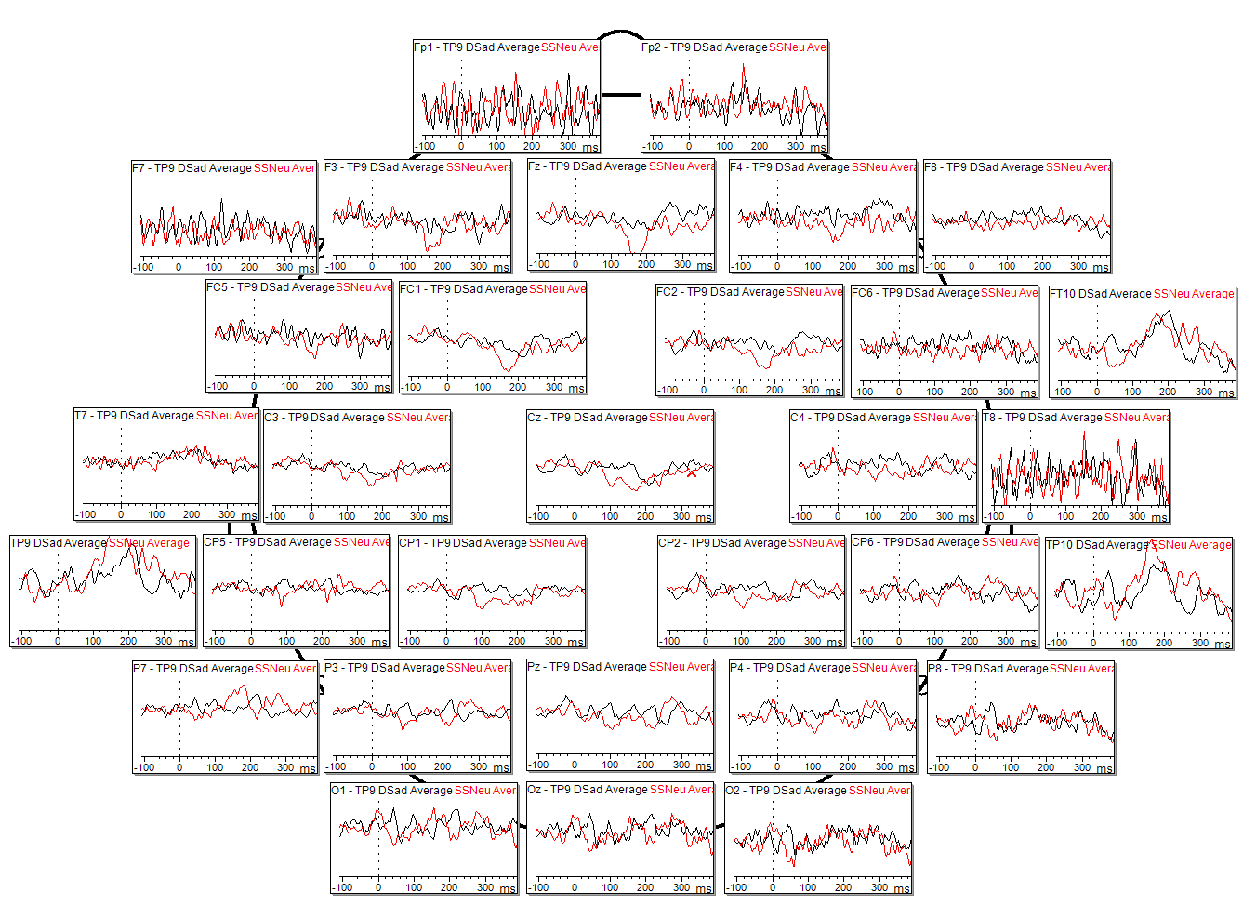
Individual Results – Sub016
Fear Deviant vs Neutral Standard
Angry Deviant vs Neutral Standard
Sad Deviant vs Neutral Standard
Scale: 10µV

Slide 22



Individual Results – Sub017
Fear Deviant vs Neutral Standard
Angry Deviant vs Neutral Standard
Sad Deviant vs Neutral Standard
Scale: 10µV

Slide 23



Individual Results – Sub018
Fear Deviant vs Neutral Standard
Angry Deviant vs Neutral Standard
Sad Deviant vs Neutral Standard
Scale: 10µV

Slide 24



Individual Results – Sub019
Fear Deviant vs Neutral Standard
Angry Deviant vs Neutral Standard
Sad Deviant vs Neutral Standard
Scale: 10µV

Slide 25



Individual Results – Sub020
Fear Deviant vs Neutral Standard
Angry Deviant vs Neutral Standard
Sad Deviant vs Neutral Standard
Scale: 10µV

